Slide 1
Series solution of differential equations Legendre polynomials
In this lecture we will:
Use the power series method to solve general differential equations.
Use the power series technique to solve Legendre’s equation using Legendre polynomials.
Look at some properties and applications of Legendre polynomials.
A comprehension question for this lecture:
Write in terms of Legendre polynomials by using their orthonormality.
1

Slide 2
Power series solution of differential equations
So far, we have found solutions for differential equations which have a number of specific forms.
For general 1D differential equations, we can find a solution as a power series which will give us an approximation to the exact general solution for x close to a given value (often for x close to zero).
For some equations, exact solutions can be found using this power series technique.
Legendre’s equation is one such case.
Power series solution example.
Find an approximate solution to the equation:
Write down y as a polynomial:
Calculate needed derivatives:
2

Slide 3
Power series solution of differential equations
Substitute polynomial and its derivatives in differential equation.
This must hold for all values of x, so coefficients of x^{n} on LH and RH sides must be the same for all n.
Comparing powers of x⁰:
Comparing powers of x¹:
And powers of x^{r}:
3

Slide 4
Power series solution of differential equations
Hence we can write down the polynomial incorporating the relationships between its coefficients:
Further coefficients can be found using the recurrence relationship.
What are the values of the coefficients multiplying x⁴ and x⁵?
There are two arbitrary constants, a₀ and a₁ (this is a second order equation!).
These can be found using the initial conditions.
For example, if
Using this, and differentiating the polynomial solution, we see
So if
4

Slide 5
Legendre’s equation
Legendre’s equation is:
Crops up a lot in physics, in particular in quantum mechanics.
Solve using a power series.
Hence
Tidying up:
Term in x⁰:
Term in x¹:
Term in x^{r}:
5

Slide 6
Legendre’s equation
From x⁰ term:
From x¹ term:
From x^{r} term:
Rewriting this:
If we put , we see
Hence
So if n is even, the series starts at a₀ and stops at a_{n}.
If n is odd, the series starts at a₁ and stops at a_{n}.
In both cases, the solution is a finite Legendre polynomial.
6

Slide 7
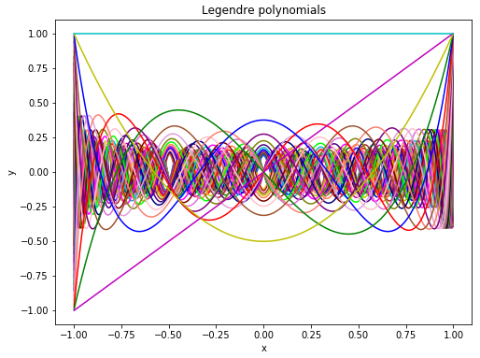
Legendre polynomials
The first few Legendre polynomials are:
Plot of first 45 Legendre polynomials:
7

Slide 8
Properties of Legendre polynomials
Legendre polynomials have interesting properties, the most important being orthonormality:
The operation is analogous to the scalar product (dot product) of two vectors.
We can think of functions defined on the interval [-1, 1] as spanning an infinite vector space.
One basis is formed by the monomials 1, x, x², x³…
The Legendre polynomials form another.
For example, we can write:
The values of c₀, c₁ and c₂ could be found by comparing coefficients of x on each side of the above equation.
Alternatively, the function x² can be projected onto the Legendre polynomial “basis vectors” using
8

Slide 9
Properties of Legendre polynomials
For example:
Cf.
Hence
The Legendre polynomials can also be constructed by using their orthonormality properties…
…and noting that:
P_{n}(x) is of degree n.
The even P_{n}(x) only contain even powers of x.
The odd P_{n}(x) only contain odd powers of x.
E.g. suppose we know and we want to find P₃(x).
Write
9

Slide 10
Properties of Legendre polynomials
Using the results above we can write:
Now so:
Look at:
But:
Hence:
By convention, the highest power has a positive coefficient.
Putting this together, we have:
10

