Slide 1
Phys108 – Mathematics for Physicists II
Lecturer:
  Prof. Tim Greenshaw.
  Oliver Lodge Lab, Room 333.
  Office hours, Fri. 11:30…13:30.
  Email green@liv.ac.uk
Lectures:
  Monday 14:00, HSLT.
  Tuesday 13:00, HSLT.
  Thursday 09:00, HSLT.
Problems Classes:
  Friday 9:00...11:00.
  Central Teaching Labs, GFlex.
Outline syllabus:
  Matrices.
  Vector calculus.
  Differential equations.
  Fourier series.
  Fourier integrals.
Recommended textbook:
  “Calculus, a Complete Course”, Adams and Essex, (Pub. Pearson).
Assessment:
  Exam end of S2: 70%.
  Problems Classes: 20%.
  Homework: 10%.
1

Slide 2
Vector calculus – the gradient of a scalar field
In this lecture we will:
  Revise partial differentiation.
  Introduce scalar and vector fields.
  Look at some methods of visualising scalar and vector fields.
  Define the gradient of a scalar field.
  Look at electric fields and potentials.
Some comprehension questions for this lecture.
  Explain which of the following can be represented as scalar and which as vector fields:
    Atmospheric pressure.
    Ocean currents.
    Height above sea level across the UK.
  Calculate the electric field associated with the electric potential
2

Slide 3
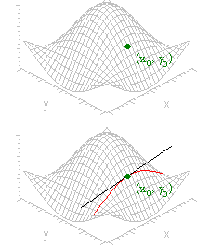
Some revision – partial derivatives
Consider a function of two variables, f(x, y).
The partial derivatives of this function w.r.t. x and y are defined by:
Example: f(x, y) = xy².
Geometrically, consider z = f(x, y) as shown opposite:
Keep y = y₀, then z = f(x, y₀) traces out the red curve shown.
The slope of this curve at (x₀, y₀) is given by
3

Slide 4
Some revision – partial derivatives
Calculate the following derivatives:
4

Slide 5
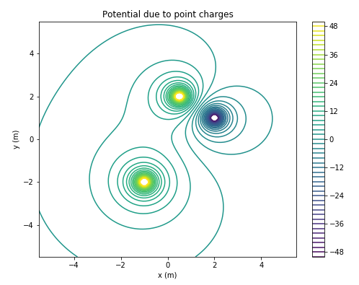
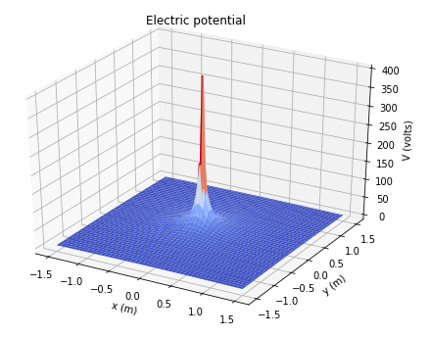
Scalar fields
A scalar field is a scalar that is defined at all points in space.
Example, electric potential around point charge:
Can plot in “3D” for field defined in (x, y) plane, or use contour plot.
The contours are “equipotentials”:
5

Slide 6
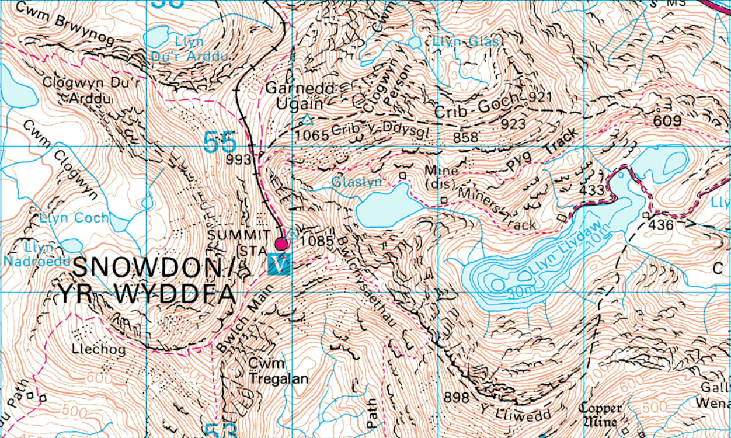
Contour plot of Snowdon
6

Slide 7
Scalar fields and equipotentials
Electric potential in drift chamber illustrated using equipotentials.
Electric field always normal to equipotentials.
Electrons produced in drift volume by high energy charged particle passing through gas in chamber.
Electrons drift along electric field lines to anode wires (central potential wells) where they produce electrical signals.
Drift electric field ~ 1 MV/m.
Using information on time taken for electrons to reach wires, reconstruct path of high energy charged particle.
32 mm
56 mm
7

Slide 8
Vector fields
A vector field is a vector that is defined at all points in space.
Physical examples include the electric field, e.g. that surrounding a point charge can be sketched as:
Can represent a vector field defined in the (x, y) plane using arrows in the direction of the vector whose length is proportional to the magnitude.
+q
8

Slide 9
Scalar and vector field examples
A scalar field is defined by:
What is the value of the field at the point ?
A vector field is defined by:
What is the magnitude of the field at the point ?
What is its direction at the origin?
9

Slide 10
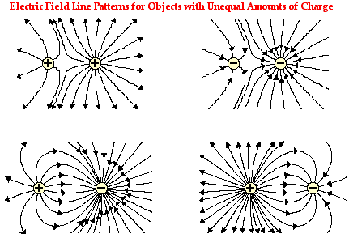
Vector fields and field lines
Electric field lines are another way of visualising E fields.
Lines trace path followed by (slow) test charge.
Density of lines proportional to field strength.
Examples shown opposite.
Note that positive and negative charges are not balanced – how can you tell this?
10

Slide 11
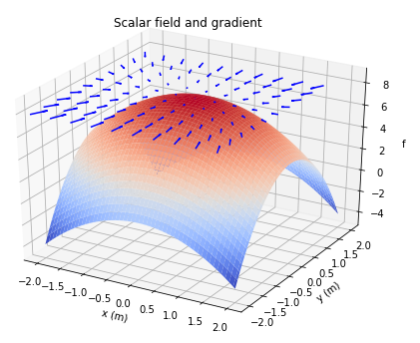
Gradient of a scalar field
The gradient of a scalar field f(x, y, z) is defined by:
The gradient of a scalar field is a vector field.
Can also write as row vector:
Example, in 2D (so can draw on screen).
f(x, y) = – x² – 2y² + 8,
11

Slide 12
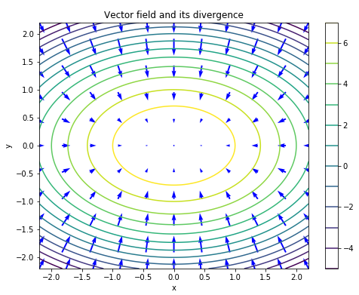
Gradient of a scalar field
Plot the scalar field
f(x, y) = – x² – 2y² + 8
as a contour plot.
Plot the field’s gradient
as a vector plot.
12

Slide 13
Gradient of a scalar field
The gradient vectors point in the direction of the steepest slope of the scalar field at the positions at which they are defined.
The magnitude of the gradient vector gives the steepness of the slope (the gradient).
A physical example:
Around a point charge q:
Calculate E field using our prescription, x component:
13

Slide 14
Calculating
Doing the same for the y and z components we have:
and
Hence:
Now, x/r = cos θ_{xr} is the component of the radius vector in the x direction, y/r that in the y direction and z/r that in the z direction, so we see:
...the E field is directed radially away from the charge, as expected.
+q
14

