Slide 1
Lecture 14: Radiation detectors III
Germanium detectors
Interactions in surroundings
Graded shielding
Linear Attenuation Coefficients
Build-up factor
Spectrum Analysis

Slide 2
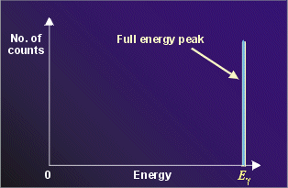
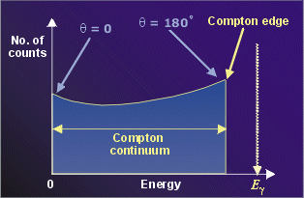
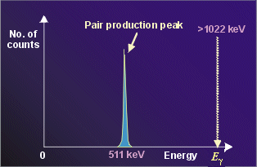
How do γ-rays Interact with Matter?
Gamma-ray photons can interact with matter through 3 primary processes:
Photo-electric absorption.
Compton Scattering
Pair Production.
An electron with a finite energy
will be left in the semiconductor
material.

Slide 3
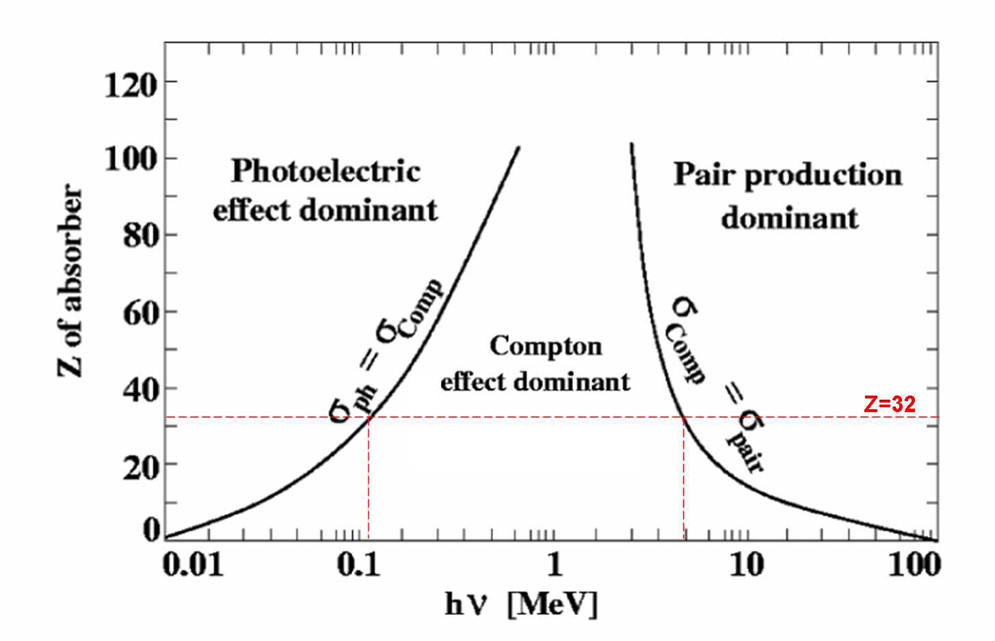
Compton Scattering

Slide 4
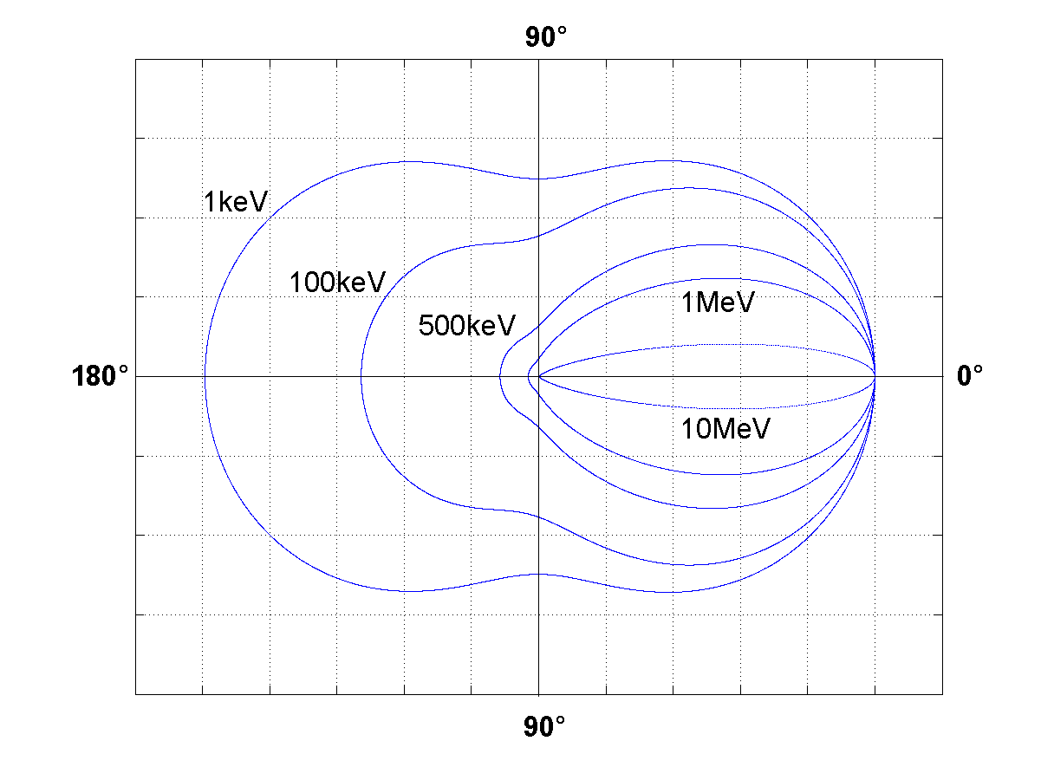
Klein-Nishina equation

Slide 5
Interactions with surroundings
Gamma-ray photons from the source will undergo interactions with the surroundings of the detector, i.e. the:
the shielding
the cryostat
the detector cap
the source mount etc
These unavoidable interactions can influence the shape of the spectrum recorded by the detector.
Interactions in shielding

Slide 6
The graded shield
For the common shielding material lead.
X-ray peaks at energies between 70-85 keV.
These X-rays introduce unwanted background particularly for low energy gamma-ray measurements.
The solution is to use a graded shield:
The inner surface of the lead shield (~10 cm thick).
A thin layer of cadmium (~3 mm)
A thin layer of copper (~0.7 mm)
Example!

Slide 7
Typical low level counting system
Lead (aged)
γ
γ
Cadmium
Copper

Slide 8
Backscattering
Close inspection of a gamma-ray spectrum may reveal a wide peak with energy <250keV which does not correspond to a known photon from the source.
Such a feature, termed a Backscatter peak, is due to gamma-rays which first interact by Compton scattering with the shielding.
Backscattered gamma-rays are those scattered through a large angle (> 120°) by the shielding.
Example!

Slide 9
Shielding and Pair Production
Pair production in the surrounding material of the detector gives rise to the 'annihilation peak' at 511 keV in the energy spectrum.
This is due to the escape of one of the 511 keV gamma-rays to the detector.
The mechanism is similar to the double and single escape peaks in the detector but only one of the 511 keV photons can ever reach the detector because they are emitted in opposite directions.
The annihilation peak in a spectrum only arises if the source emits at an energy greater than 1022 keV.

Slide 10
Attenuation Coefficients
When a collimated beam of monoenergetic gamma-ray photons passes through a material, the interaction processes remove gamma-rays by absorption or by scattering the gamma-rays away from the detector direction.
The linear attenuation coefficient :
describes the probability of absorption occurring per unit length within the absorber material;
it is also sometimes related to the density of the absorber material and called the mass attenuation coefficient.
Linear attenuation coefficients for certain gamma energies and absorber materials are found from linear attenuation graphs.

Slide 11
The build up factor
If we insert an absorber between the source and the detector, some of the transmitted gamma-rays still travel directly from the source to the detector.
As well as these, some gamma-rays which would not otherwise reach the detector may be Compton scattered in the absorber, such that they then reach the detector.
This can increase the signal at the detector.
This phenomenon is referred to as build-up.
Example!

Slide 12
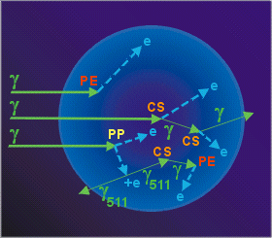
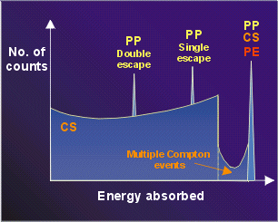
Interactions in a real detector
Within a real detector the interaction outcome is not as simple to predict as the small or large detector case. Compton scattering may be followed by other Compton scatterings before the gamma-ray photon escapes from the detector. Also, pair production may be followed by the loss of only one annihilation gamma-ray, resulting in a single escape peak as well as a double escape peak.

Slide 13
Schematic Gamma Spectrum
a
c
b
d
e
h
Number
of
counts
f
g
i
0
500
1000
1500
2000
2500
Energy (keV)
A radionuclide is known to decay by high-energy positron emission and to emit two gamma rays. One of these is at 300 keV. When a low activity source of this nuclide is counted close to a germanium detector the following spectrum is seen.
How might we understand the features in this spectrum?

Slide 14
Schematic Gamma Spectrum
a
300 keV
b
d
e
2100 keV
Number
of
counts
f
g
Sum peak
0
500
1000
1500
2000
2500
Energy (keV)
First label the known and identify the other photopeak
Look at the top - this could be 2100 keV or 2500 keV
2100 + 300 = 2500. So 2100keV is the photopeak and 2500 is the sum peak when the nucleus decays an both gammas are simultaneously detected.

Slide 15
Schematic Gamma Spectrum
X-rays
Back scatter
300 keV
511 keV
Double escape
2100 keV
Number
of
counts
Single escape
Compton edge
Sum peak
0
500
1000
1500
2000
2500
Energy (keV)
We would expect both single and double escape peaks.
The Compton continuum from the 2100 keV photopeak should also be seen there we will see the Compton edge.
X-rays, 511 keV and a backscatter peak should also be seen.

Slide 16
Standard Analysis procedures
If you want to analyse real spectra you need to perform:
Energy calibration
Peak Shape Calibration
Efficiency Calibration
You can then convert peak areas to true intensities
In a gamma-ray spectrum a peak consists of a number of counts in several adjacent channels.
Simplest peak area is just the summation of the channel contents within the peak.
Gross Count or Gross area.

Slide 17
Energy Calibration
Energy calibration is achieved by collecting a spectrum of a known radioisotope and recording the channel number of the peaks of known gamma-ray energy.
Known
Energy
(keV)
Integral non linearity
linear calibration
Intercept (keV)
Measured peak position
(channels)
Energy calibration
Factor (keV/channel)

Slide 18
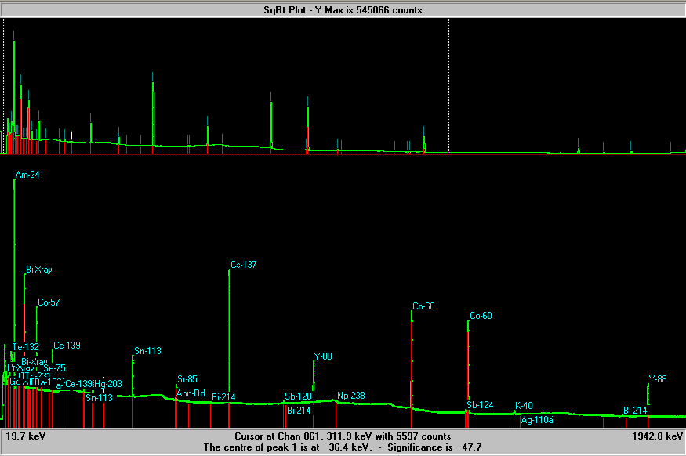
Real Calibration Spectra: Energy
This is a typical mixed source calibration spectrum

Slide 19
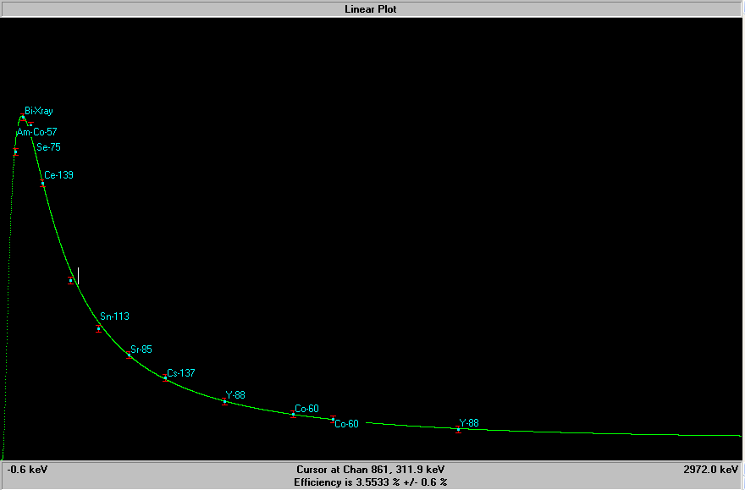
Real Calibration Spectra: Efficiency
Efficiency
The efficiency curve from an n-type detector

Slide 20
Counting geometries
For low level counting it is important to maximise detector efficiency:
For large quantities of sample utilise a Marinelli beaker.
For small samples place in known geometry on top of detector – or utilise a well detector.
Marinelli geometry
Well geometry

Slide 21
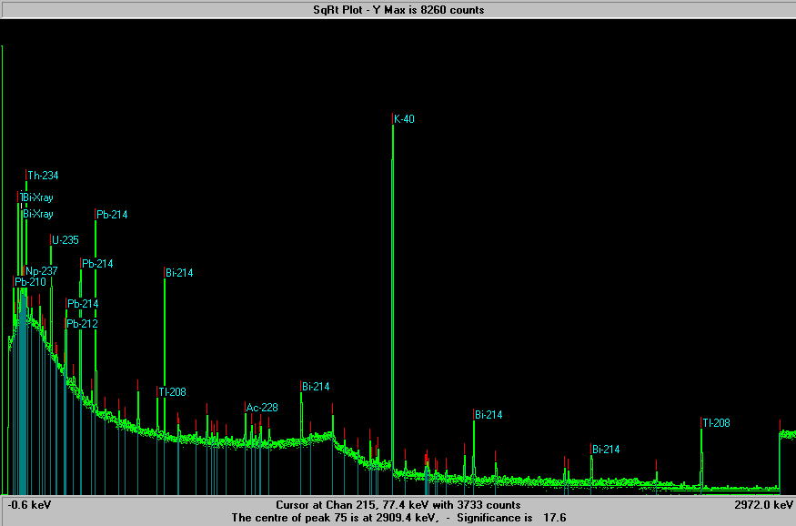
Real Unknown Spectra: Sample
Unknown marinelli sample

Slide 22
Analysing a real unknown spectrum
In general analysis of a spectrum may take the following form:
Search for peaks.
Measure the width of peaks.
If the width is consistent with the energy perform a peak area calculation.
If peak is too wide, deconvolute the peaks.
Identify peaks in particular isotopes.
Use the efficiency calibration to determine the intensities of the peaks and estimate the isotope activities.

Slide 23
Lecture 14: Radiation detectors III
Germanium detectors
Interactions in surroundings
Graded shielding
Linear Attenuation Coefficients
Build-up factor
Spectrum Analysis

