Slide 1
Zlumi Meeting
Michael O’Keefe

Slide 2
Code Structure
Setup now so that all steps are more automated
So in theory could run over all data automatically (just need a script that would find and list all the AOD files)
Three main scripts are: submit_grid.sh, retrieve_grid.sh and run_code.sh (and then get_plots.sh to make the plots)
These codes work based on the following directory structure:
Main Directory
DATA |  |  | Outputs |  |  | plots
DATA15 | DATA16 | DATA17 | DATA15 | DATA16 | DATA17

Slide 3
Code Structure
1 – Make a list of all AODs you want to run over in filelist.txt
2 – Run the script submit_grid.sh to submit all AODs in filelist.txt to the grid, and name the outputs based on the container name, i.e. if your input AOD is: data16_13TeV.00304008.physics_Main.merge.AOD.r9264_p3083 your grid job will be named, for example: user.miokeefe.DATA16.304008. 20180115.112304._EXT0. This matters later for the directory structures. Submit_grid.sh also outputs the name of your grid jobs to a .txt file called grid_submissions.txt to help you retrieve them later.
3 – Then run retrieve_grid.sh. This will download each of your jobs and store them in the correct directory, ./DATA/DATA16/ in this example.
4 – Then run run_code.sh. This will run the code over all files in your ./DATA/ directory. So if you have samples in DATA15, DATA16 and DATA17, this script will run the code over all of them, and output them to their corresponding directory, which again in this example would be ./Outputs/DATA16/304008/.
5 – Then if you want to make luminosity ratio plots/cross section plots, run get_plots.sh, which will make the plots and copy them to your ./plots directory. This script executes the 2 .C scripts yieldPlot.C and ratioPlot.C. Again, this script will run over all DATA/run-number directories in succession.

Slide 4
Luminosity Plots
Left: Our example job (304008). Right: Random DATA 16 run. In 304008, Z lumi is pretty much constantly above official lumi, whereas in 301932 there is good agreement early on, then Z lumi is lower, then Z lumi is higher?? Easy to see in ratio plot, gradient sloping upwards.

Slide 5
Efficiencies
Trigger efficiency
Reconstruction efficiency
*The ratio of dir/comb is used for the MC correction factor?
$$Acceptance×\left(1−{\left(1−ε_{trigger}\right)}^{2}\right)×ε_{reco}^{2}$$
$$\frac{m_Z_counter_mu}{m_sumweights}$$

Slide 6
Efficiencies
Checking out Athena and running the code that way, the top graph is produced, but not the bottom 2
By download and running the python script manually, the bottom 2 graphs are also now produced

Slide 7
Efficiencies
Neither method manages to produce these 2 graphs
* from slide 4, ratio of dir/comb is used for the MC correction factor?
*

Slide 8
Efficiencies
So trigger efficiencies of around 76% and reconstruction efficiencies of around 94%. Reasonable??

Slide 9
Official Luminosity

Slide 10
Event Counting
Event counting
Reading in each LB successively and reading the number of events in each
Working so far, but problem with reading in some LBs
Know what the problem is but not yet how to fix it…
This is the input file, next step is to count the events in the output file and compare

Slide 11
From ZLumi Meeting
“Get integrated luminosity from Massi files”. What are Massi files?
ATLAS/CMS Lumi ratios
0.9-0.95 ish for delivered lumi
0.95-1.0 ish for Z counting
ATLAS Z counts/Lumi flat $\sim 675 (pb?)$
“Loose tracking efficiency $\sim 100\%$”
$Z→μμ$ MC sample, could be useful? mc16_13TeV.361107.PowhegPythia8EvtGen_AZNLOCTEQ6L1_Zmumu.merge.AOD.e3601_s3126_r9425_r9315

Slide 12
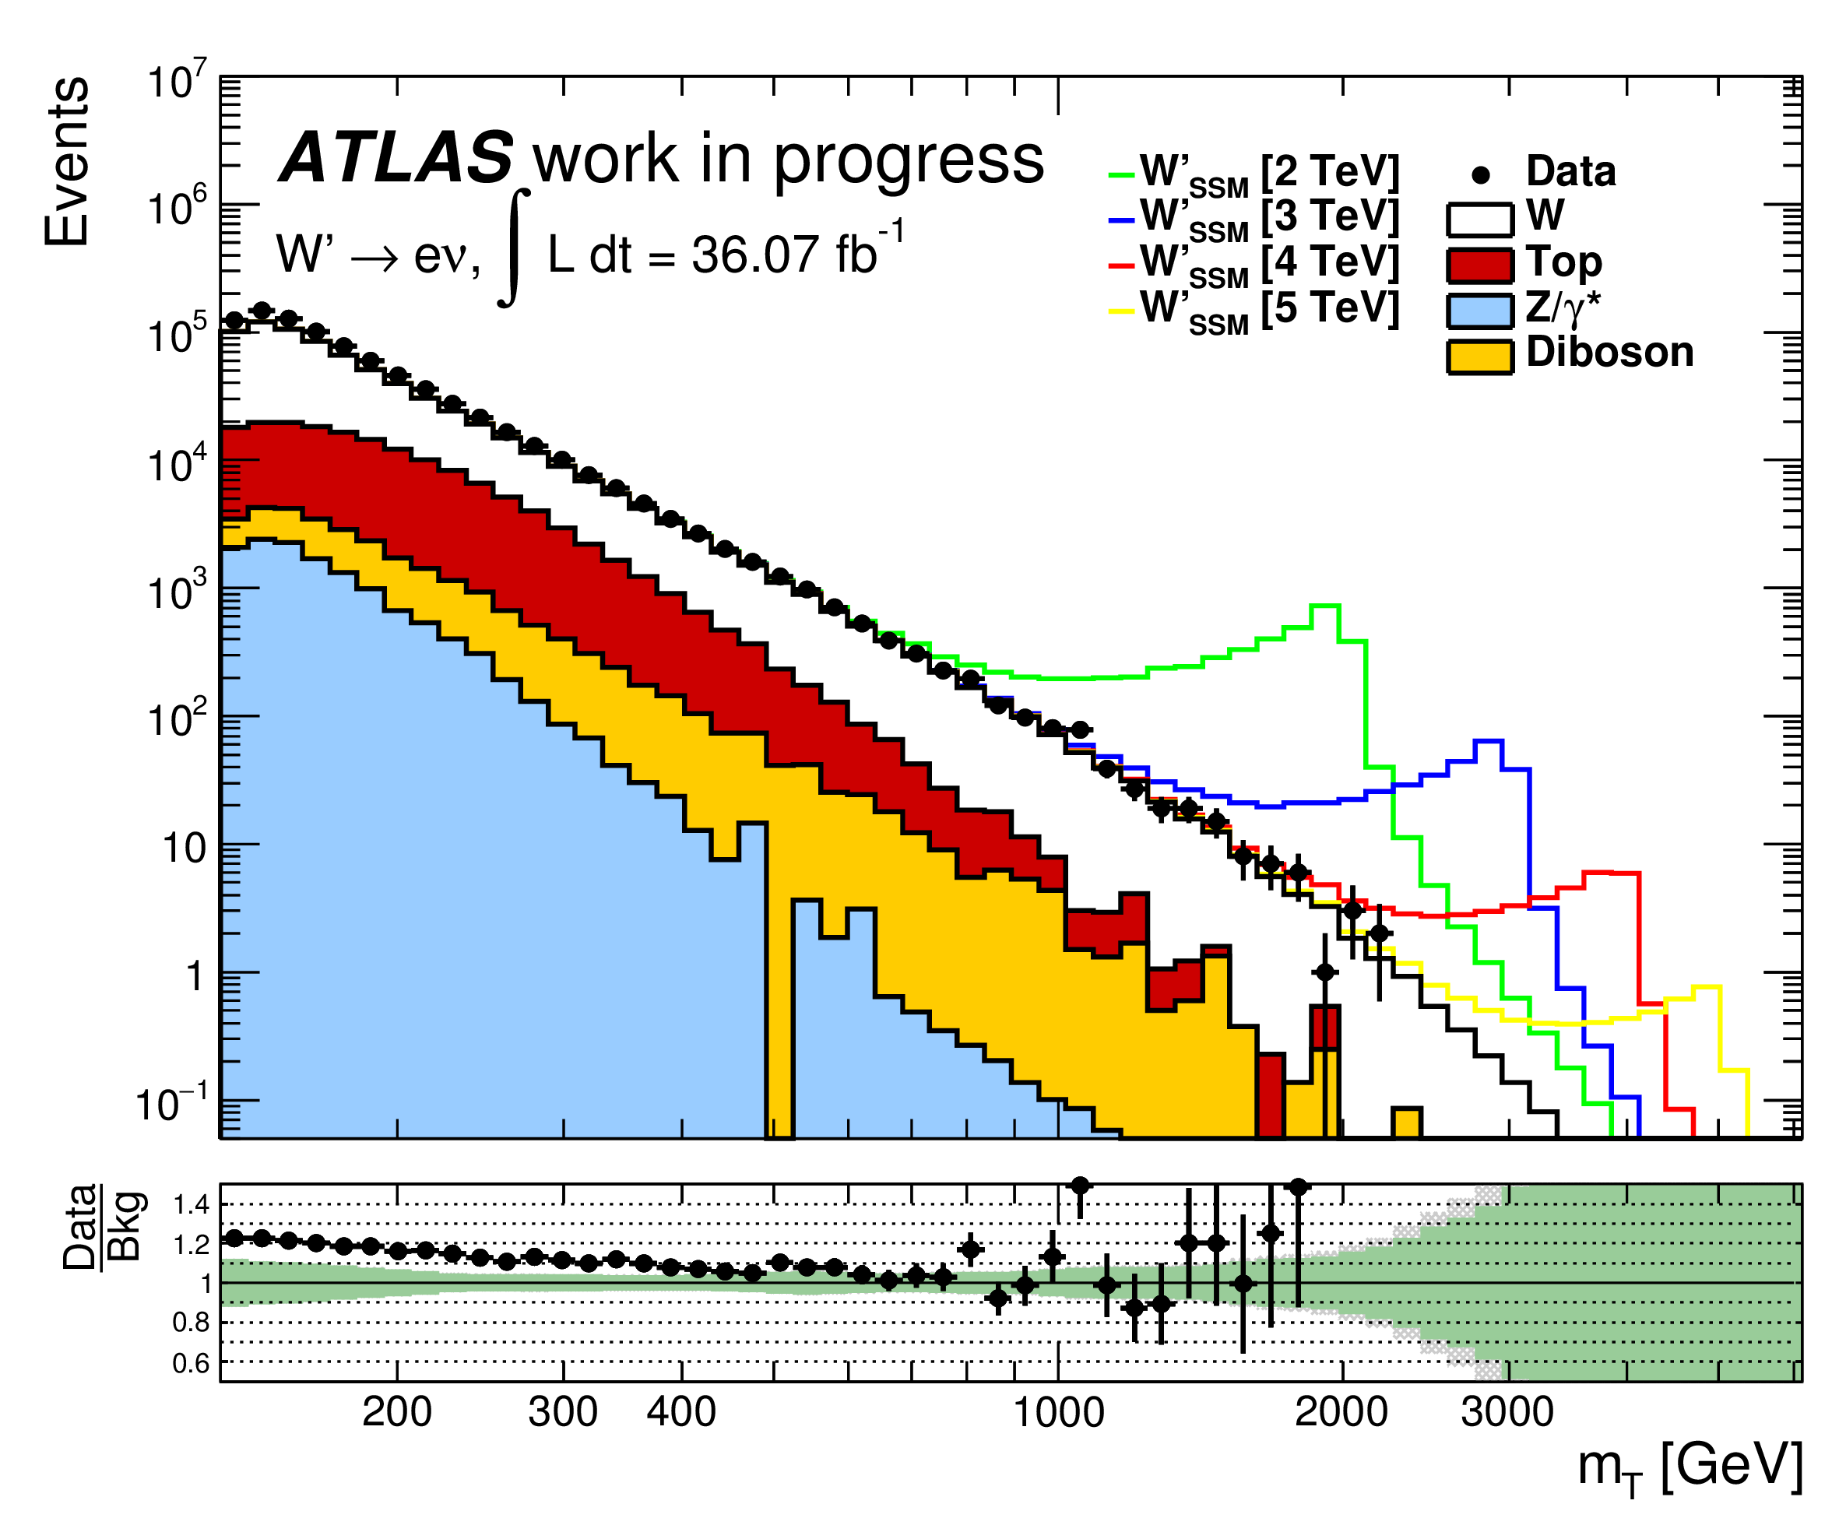
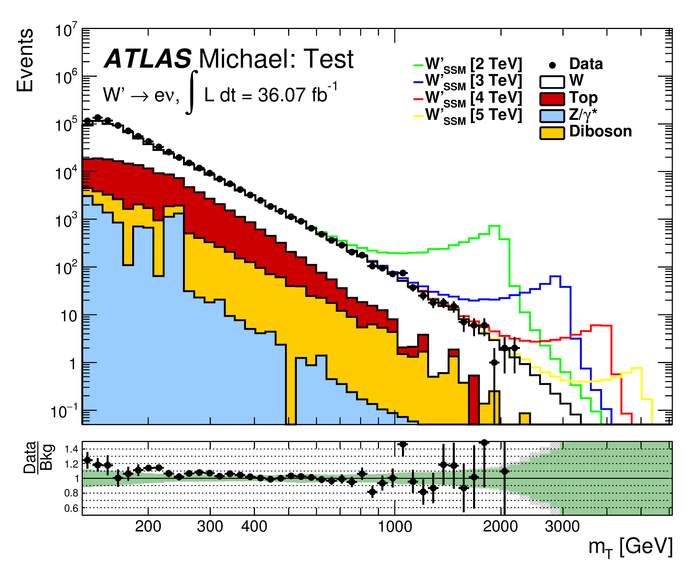
W’ MT Plot (Ignore for ZLumi meeting)
Ellis’ inputs; with fakes
Ellis’ inputs; without fakes
My inputs; without fakes
Clearly I am missing some MC samples, which I knew anyway, many jobs crashed. Also need to figure out how to run whatever code I need to run to get the fakes.

