Slide 1
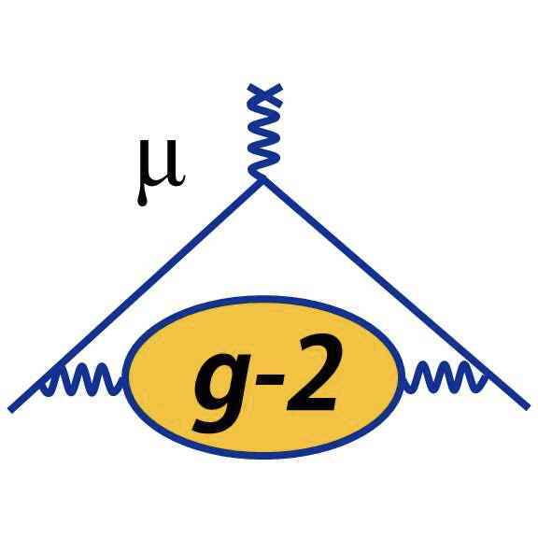



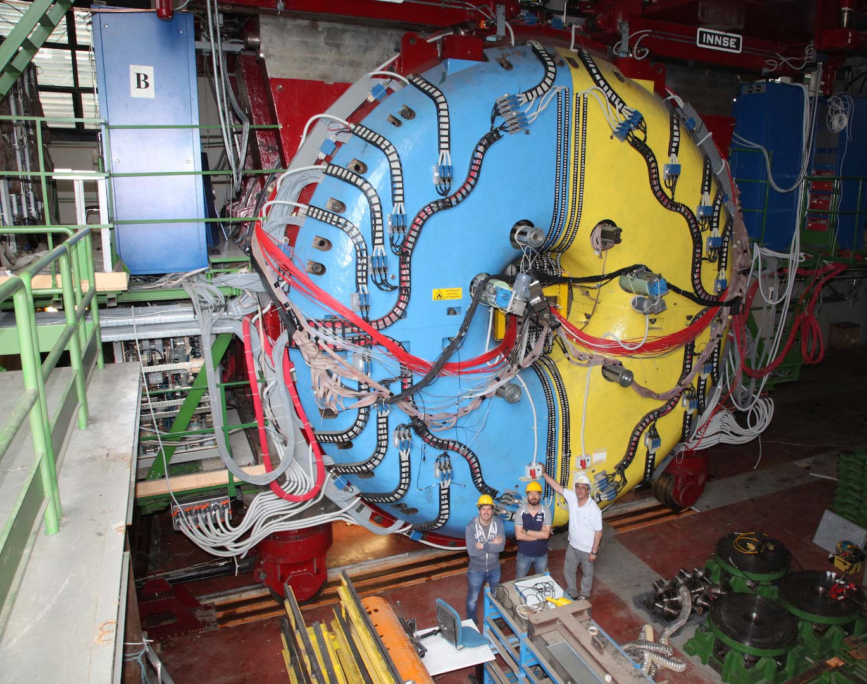
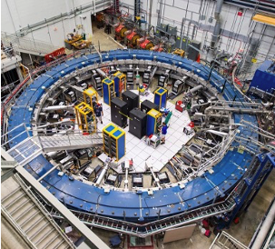
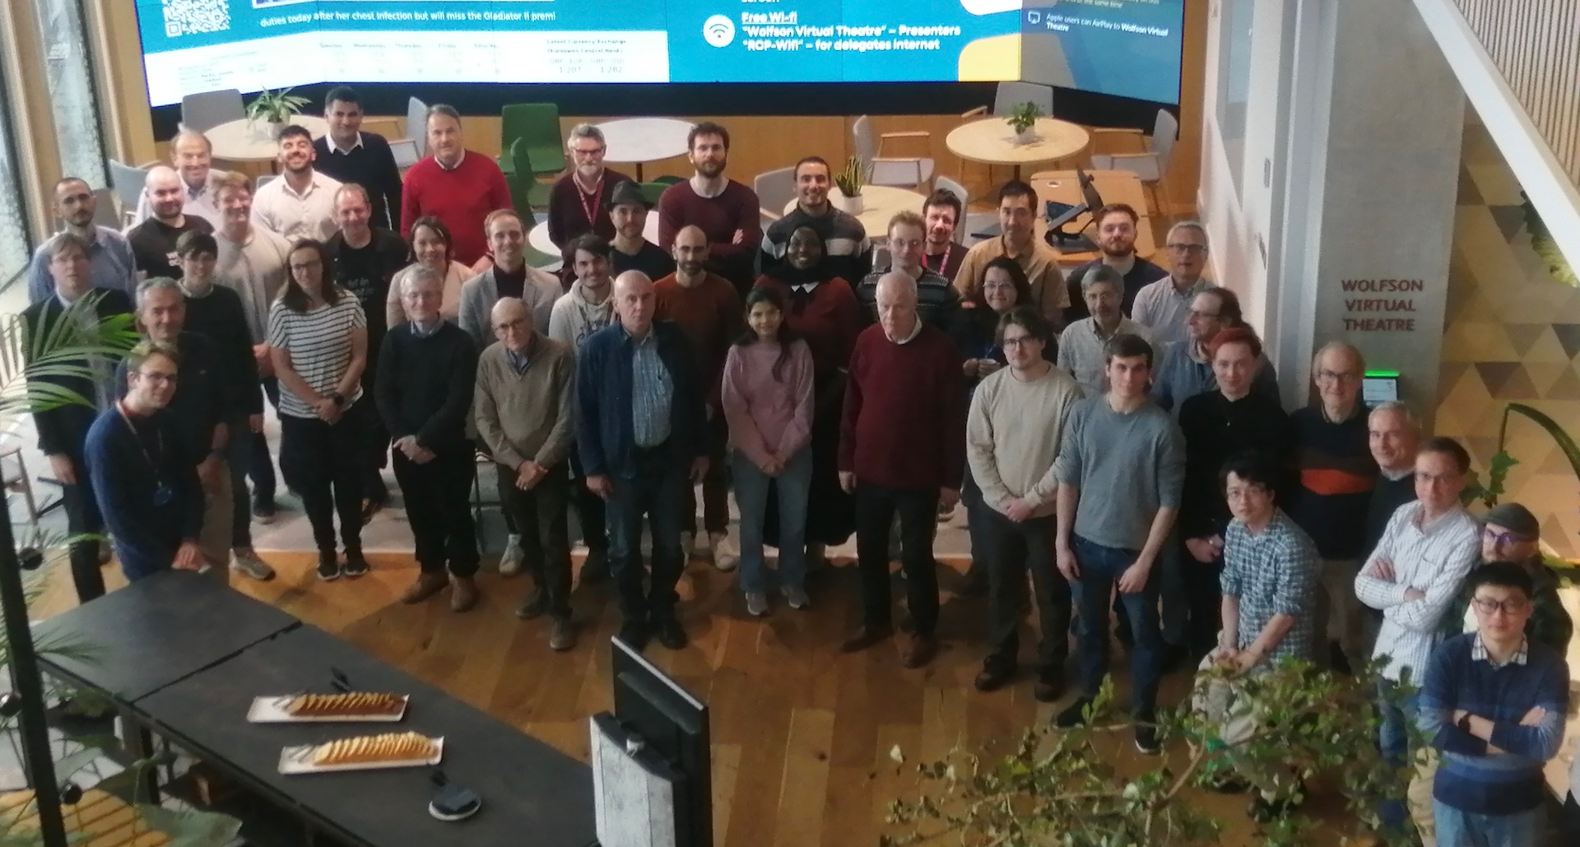
KLOE, Muon g-2 and Mu-EDM at Liverpool
Estifa’a Zaid on behalf of the KLOE-2 Collaboration FNAL g-2 Collaboration

Slide 2
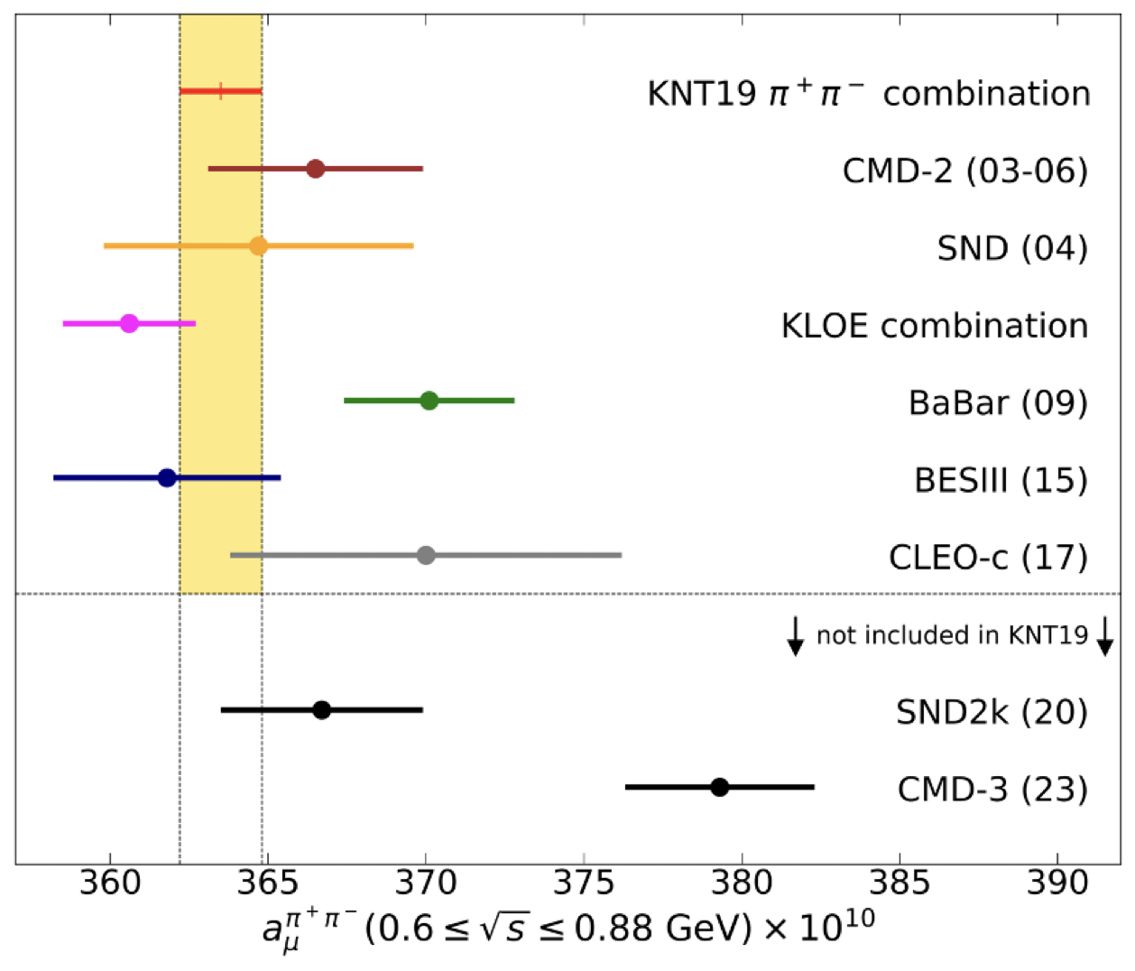
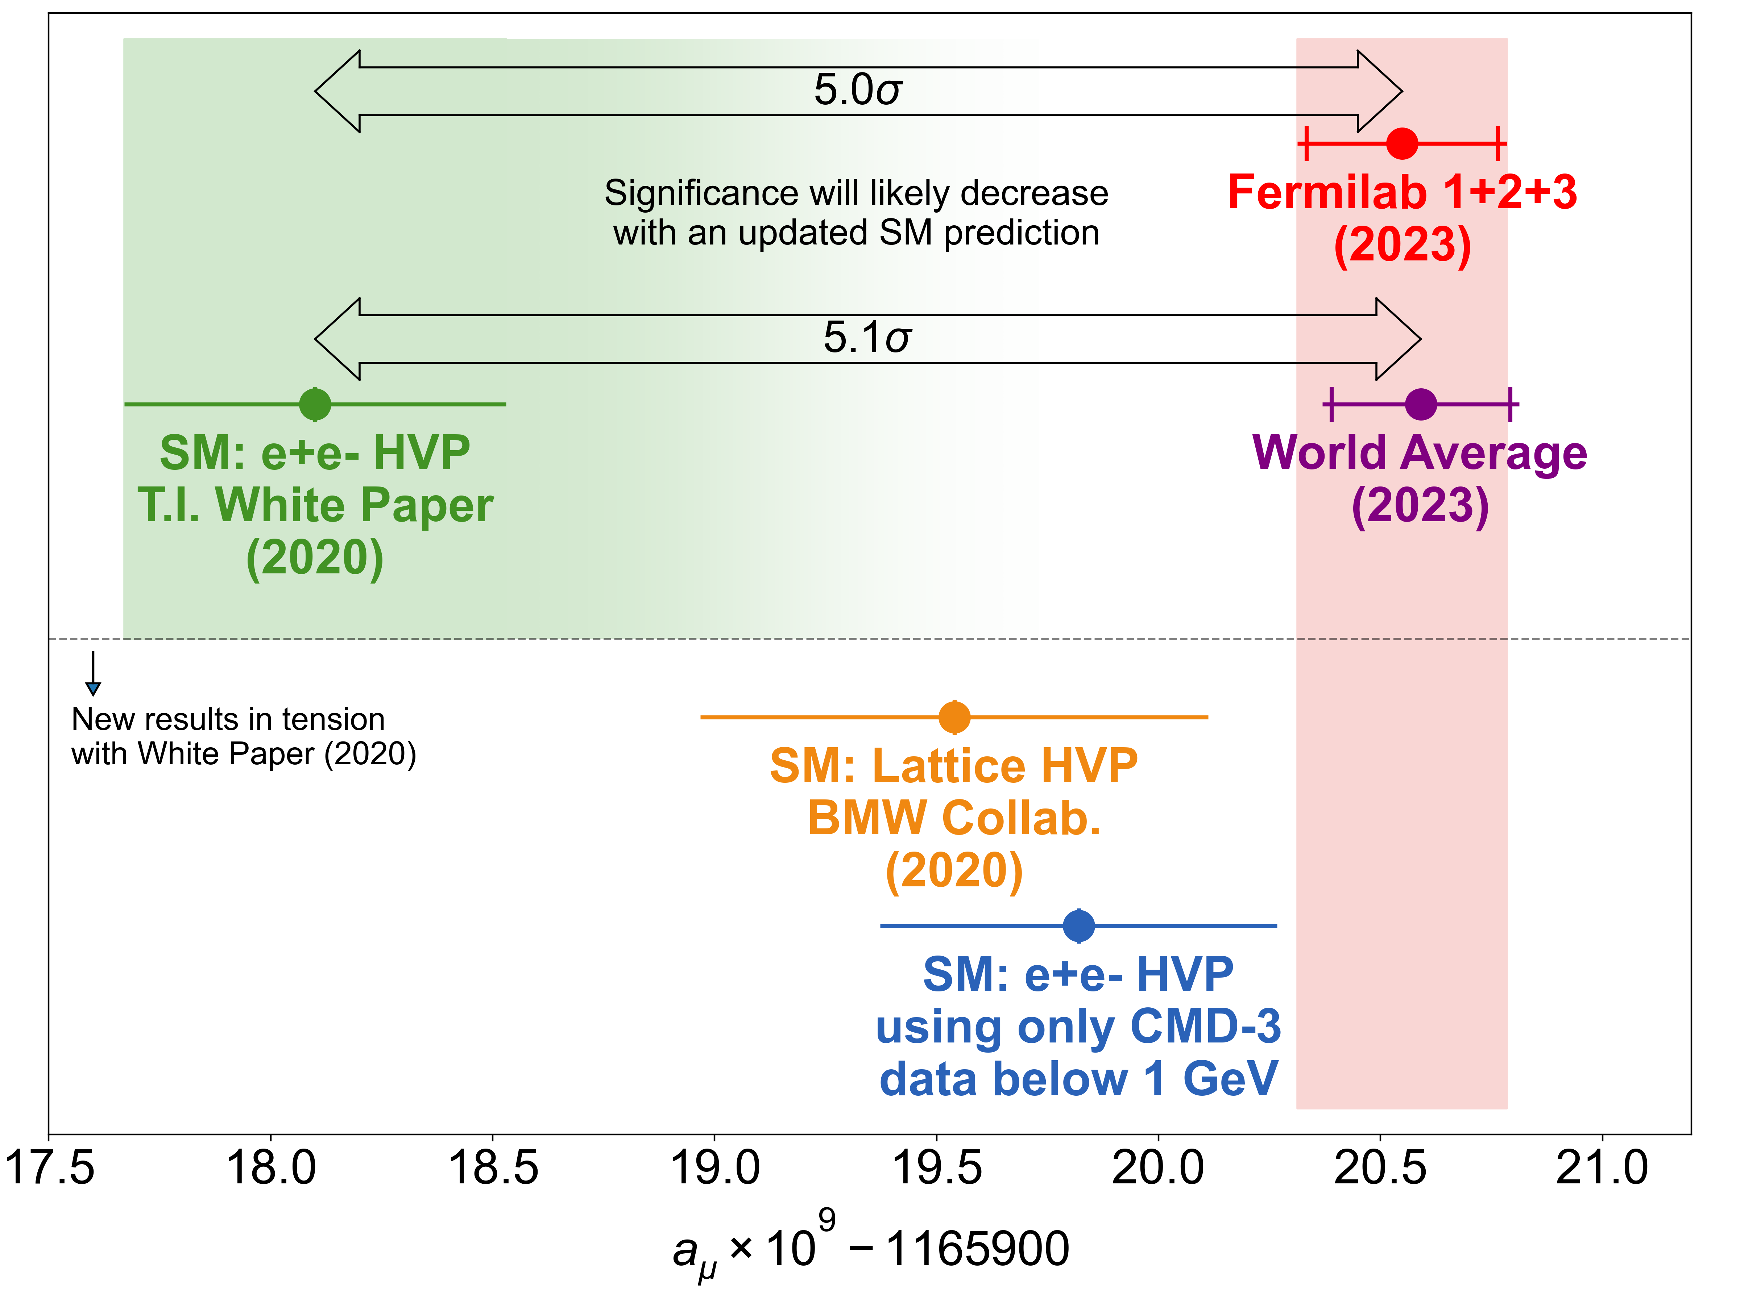

The muon g-2 Landscape
The KLOE measurements have been instrumental in shaping the current landscape of muon g-2.

Slide 3
The Current Effort
The Leverhulme Trust grant which was awarded to Graziano Venanzoni in 2022 has funded a large group in Liverpool (12 postdocs and 8 PhD students) with the aim of clarifying the muon g-2 puzzle.
Muon g-2 Experiment at Fermilab Run 4+5+6
New KLOE hadronic cross section measurement
MUonE experiment: a new approach to determining $a_{μ}^{HLO}$

Slide 4
The current effort

Slide 5
The Current Effort
New KLOE hadronic cross section measurement
Large experimental group of 15 members at Liverpool University working on the KLOE analysis as well as collaborators from Pisa, Dresden and Krakow institutes.
RadioMonteCarLow 2
Leading updated comparisons of Monte Carlo generators for low-energy physics.
  Combined effort with theory members at Liverpool University to cross check Radiative Corrections for published analyses, calculate higher order radiative corrections and develop NNLO MC generators for the new analysis.

Slide 6
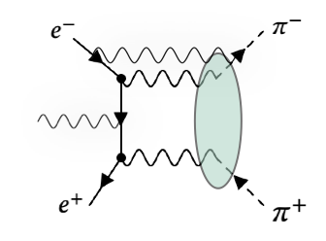
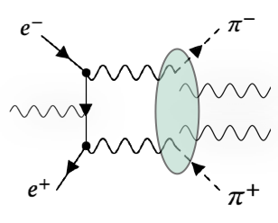
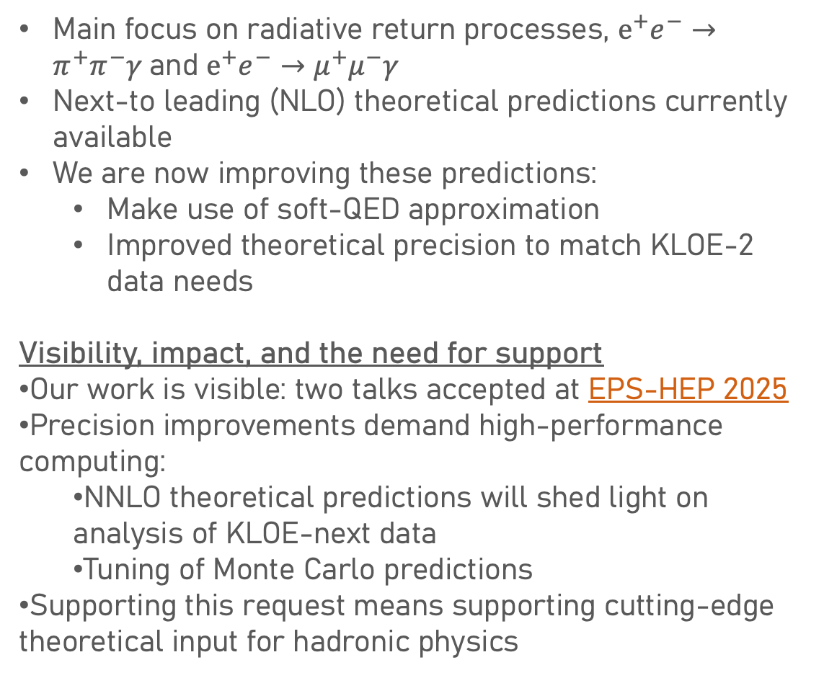
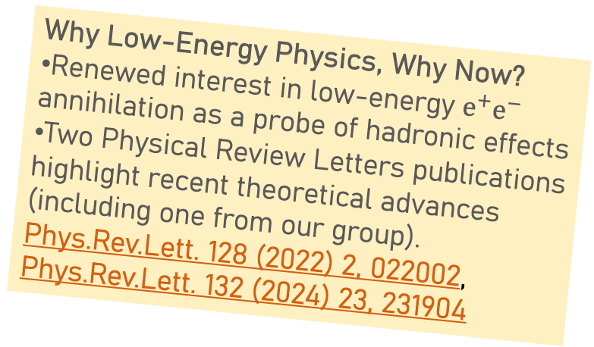
Theoretical support for the KLOE experiment
Main focus on radiative return processes, $e^{+}e^{−}→π^{+}π^{−}γ$and $e^{+}e^{−}→μ^{+}μ^{−}γ$
Next-to leading (NLO) theoretical predictions currently available
We are now improving these predictions:
  Make use of soft-QED approximation
  Improved theoretical precision to match KLOE-2 data needs
Visibility, impact, and the need for support
Our work is visible: two talks accepted at EPS-HEP 2025
Precision improvements demand high-performance computing:
  NNLO theoretical predictions will shed light on analysis of KLOE-next data
  Tuning of Monte Carlo predictions
Supporting this request means supporting cutting-edge theoretical input for hadronic physics
Why Low-Energy Physics, Why Now?
Renewed interest in low-energy $e^{+}e^{−}$ annihilation as a probe of hadronic effects
Two Physical Review Letters publications highlight recent theoretical advances (including one from our group).
Phys.Rev.Lett. 128 (2022) 2, 022002, Phys.Rev.Lett. 132 (2024) 23, 231904

Slide 7
Current KLOE hadronic cross section analysis

Slide 8
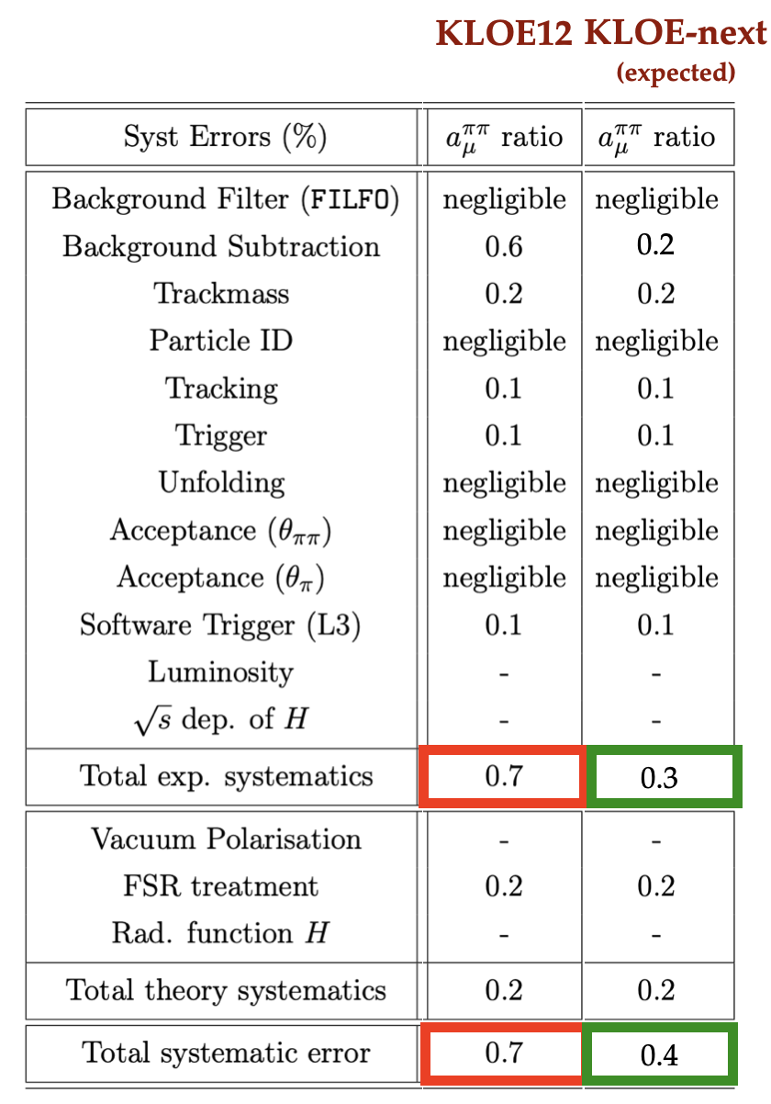
Current KLOE hadronic cross section analysis

Slide 9
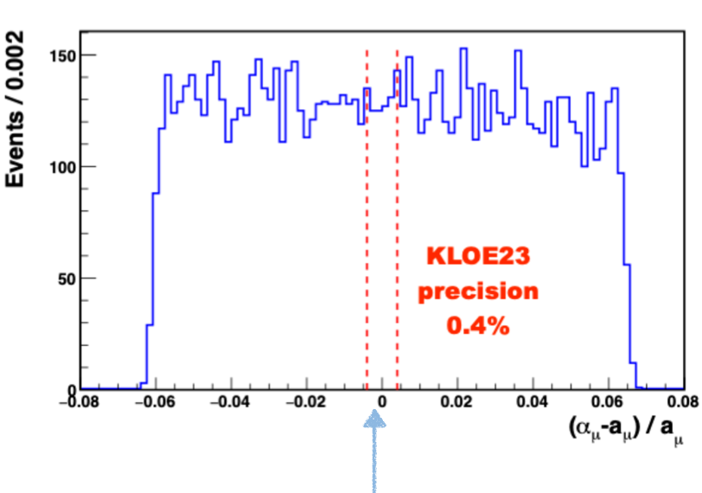
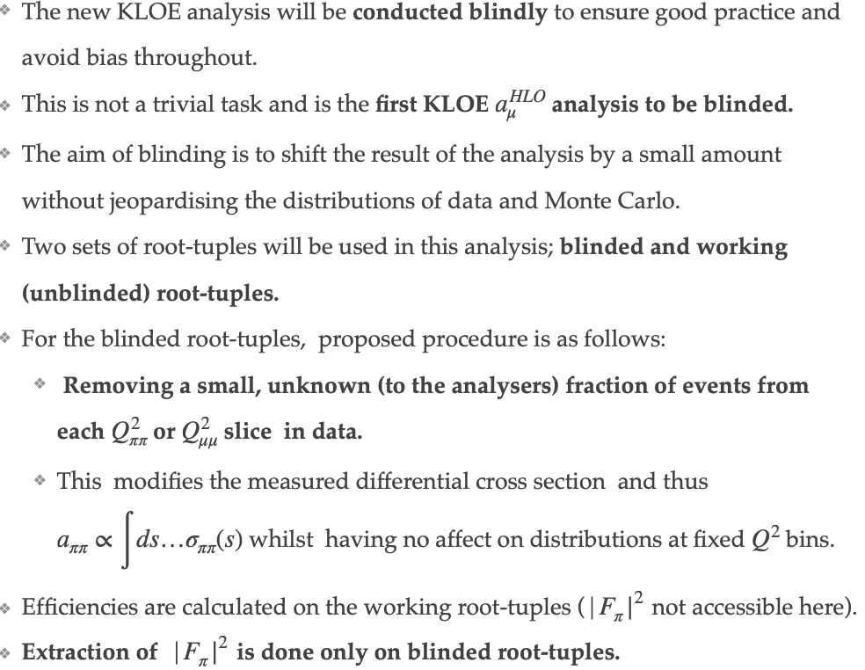
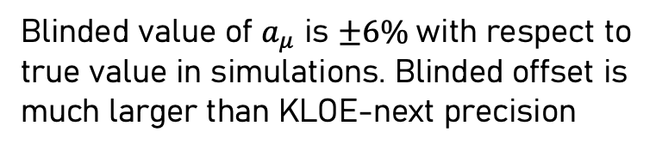
A Blinded analysis
KLOE-next precision 0.4%.
Blinded value of $a_{μ}$ is $±6\%$with respect to true value in simulations. Blinded offset is much larger than KLOE-next precision
Blinding procedure has been documented and undergone an internal review process.

Slide 10
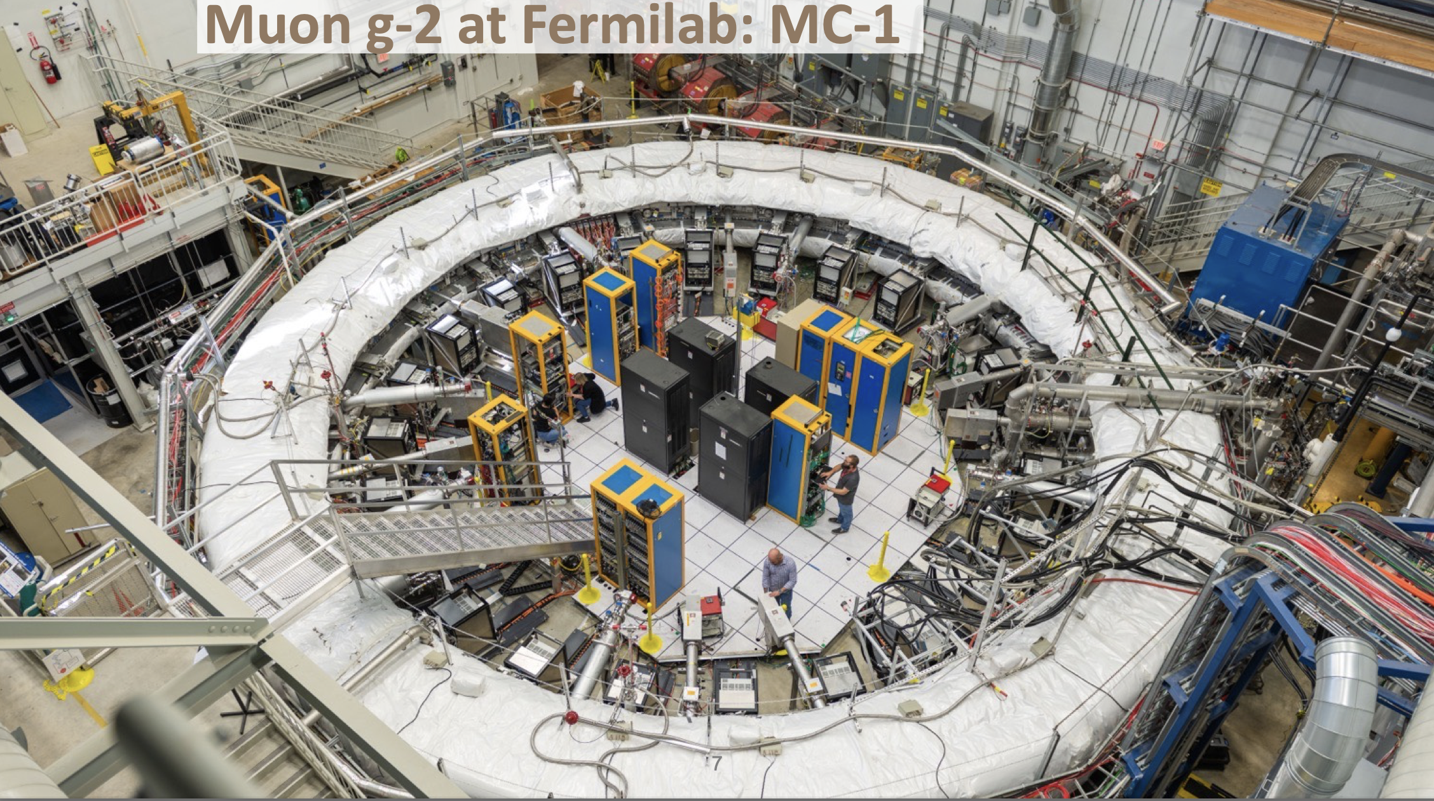

Slide 11
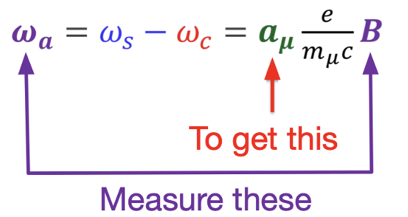



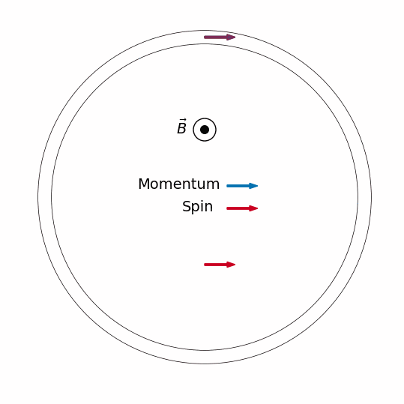
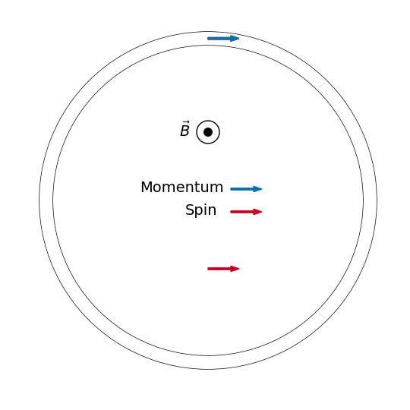


Key Principles of measuring g-2
$$θ$$
Spin rotates ahead of momentum as muon orbits the ring.
At a given point in the ring spin rotates radially in and out with a frequency of $ω_{a}$

Slide 12

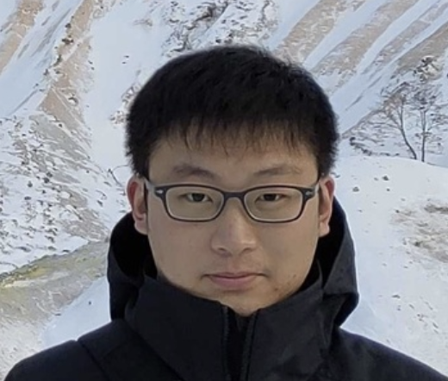
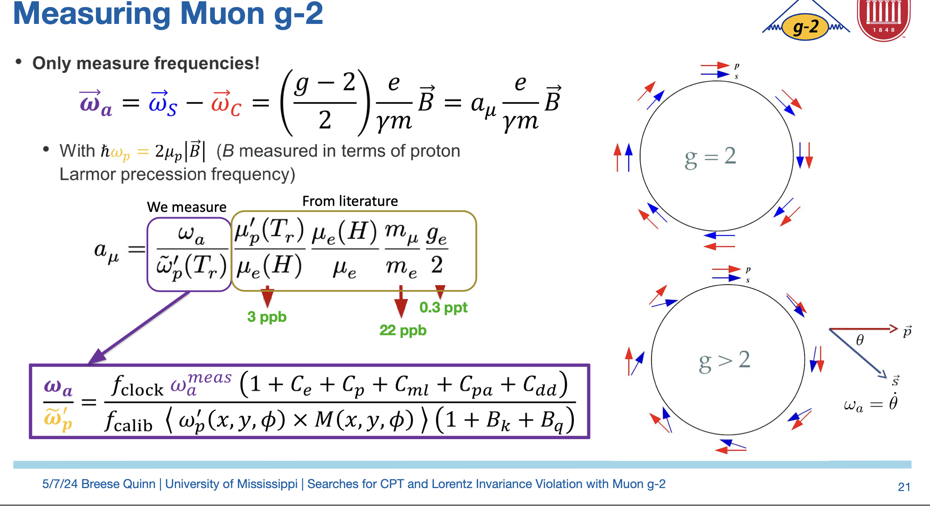

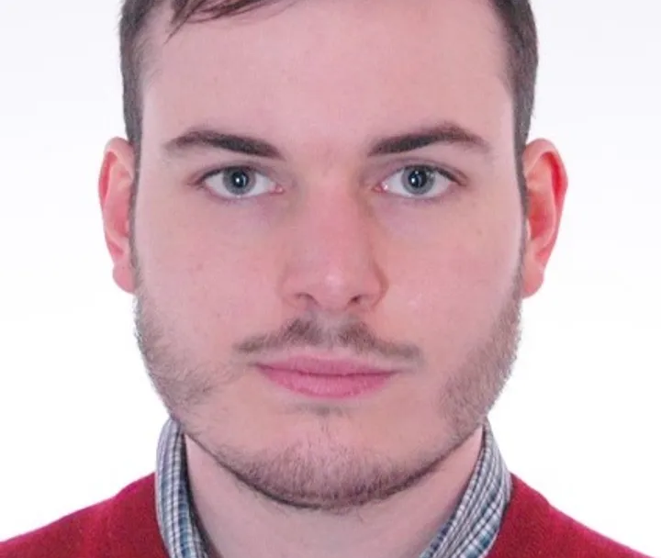
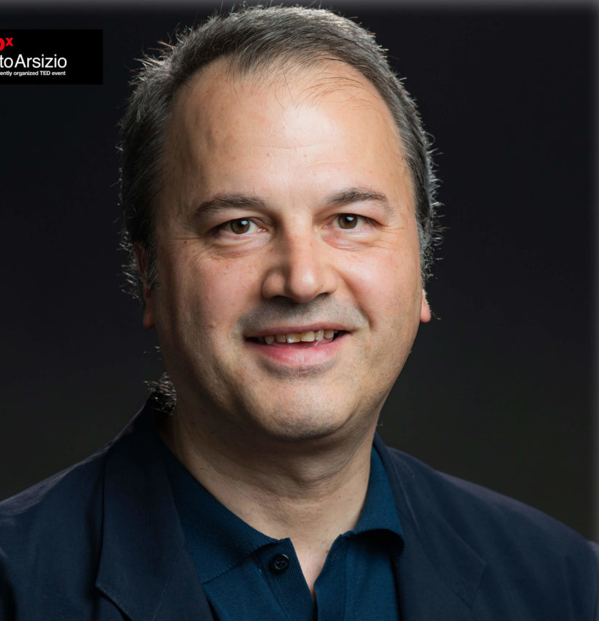

Measuring muon g-2

Slide 13
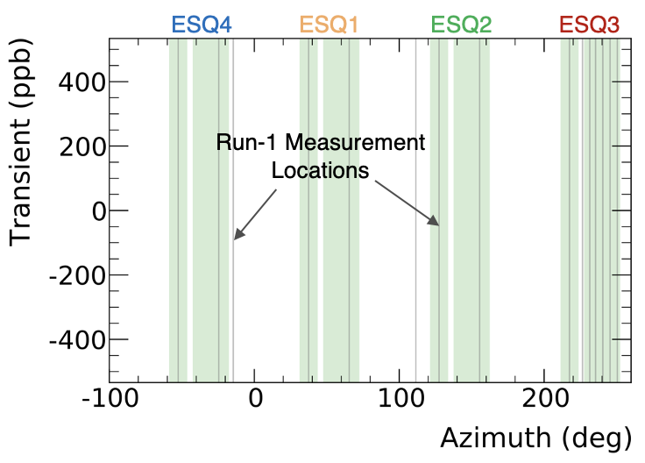
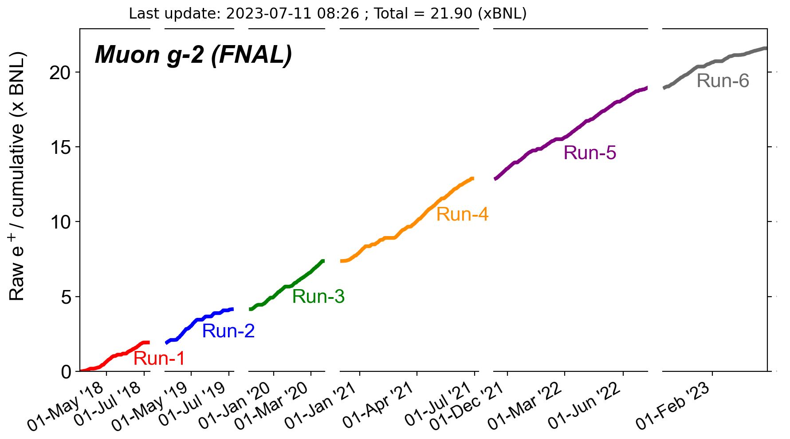
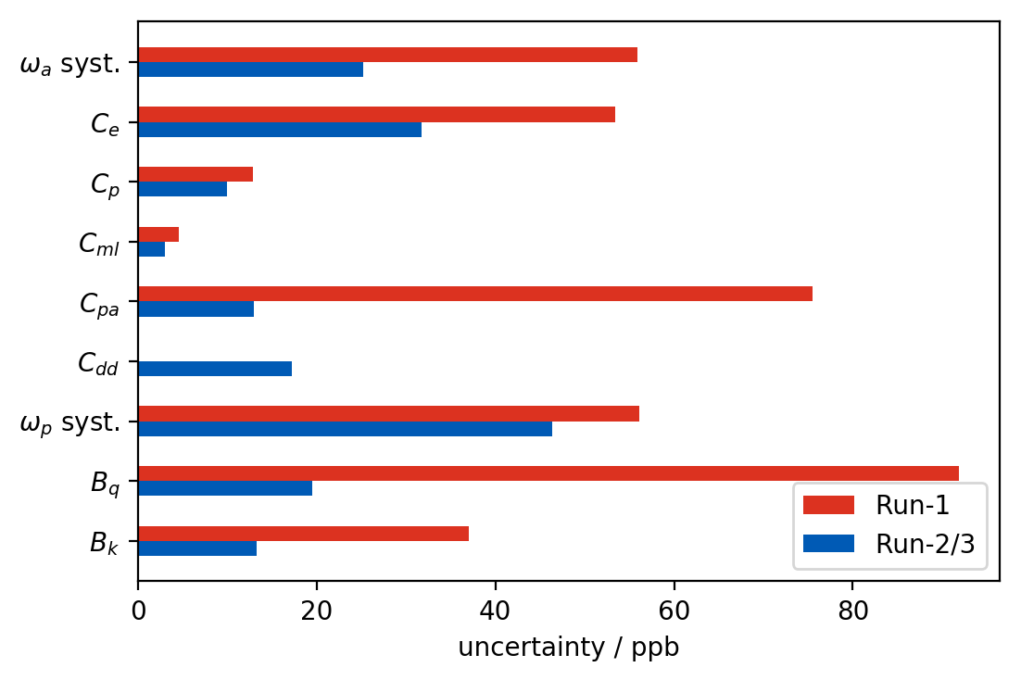


Run 2 data Collection and Result
Damaged resistors in 2/3 quad plates redesigned and replaced. Beam oscillation frequencies are more stable $C_{pa}$ reduced.
The oscillating magnetic fields from vibrating quads measured with a new NMR probe and measurement positions increased. $B_{q}$ reduced

Slide 14
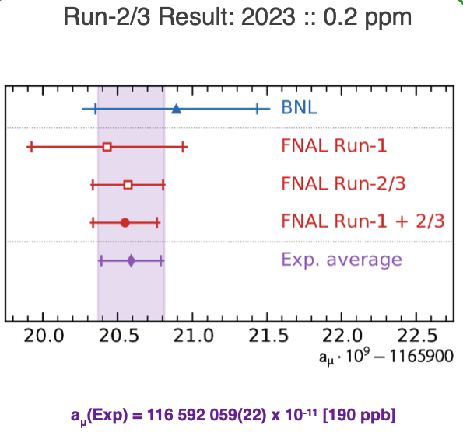
Run 2/3 data Collection and Result
0.21 ppm
[ppb] | Run-1 | Run-2/3 | Ratio
Stat. | 434 | 201 | 2.2
Syst. | 157 | 70 | 2.2
Total Systematic: 70 ppb
Statistical uncertainty is still higher than systematic.

Slide 15
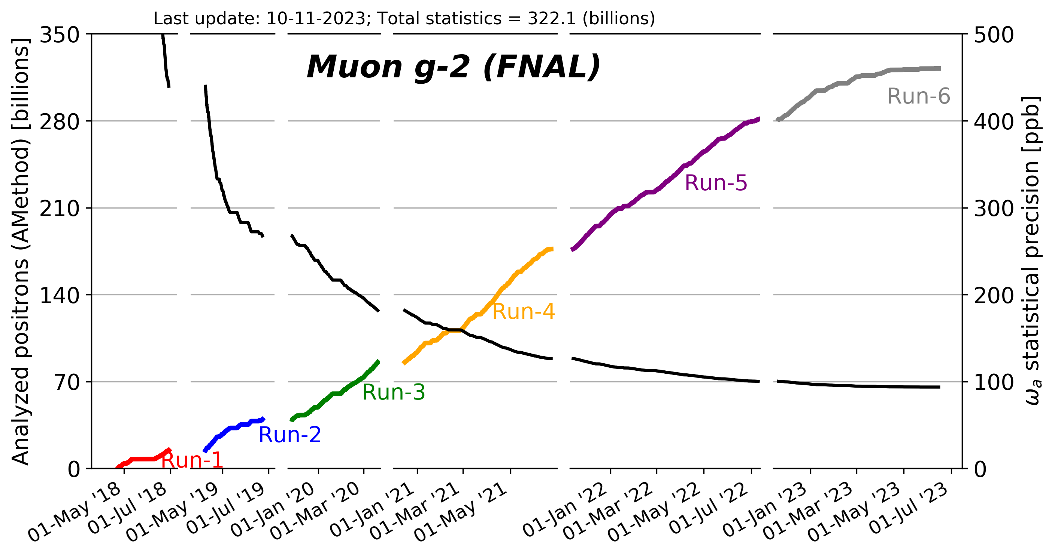
Run 4/5/6 data Collection and Final Result !
Still analysing full dataset of 322 billion positrons → Release talk scheduled for the 3rd of June 2025 (Save the Date ! )
Statistical uncertainty: with Runs 1-6 we expect to surpass design goal of 100ppb statistical uncertainty
Running conditions: Quadrupole radio frequency switched on during Run 5 and 6. This reduced radial and vertical motion of muons giving a more stable beam and less muon losses.
Systematic uncertainty: Great efforts to understand and investigate the systematics better than run 2/3

Slide 16
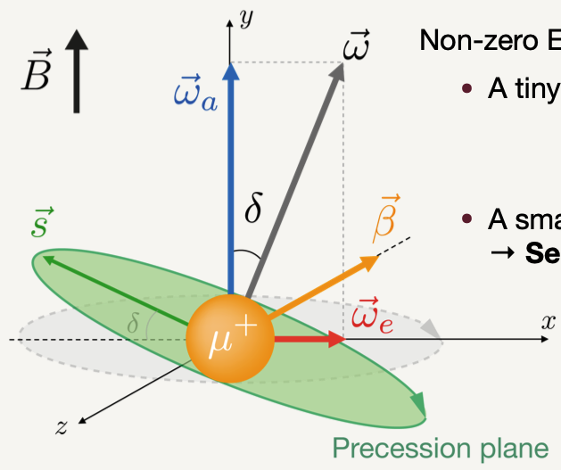
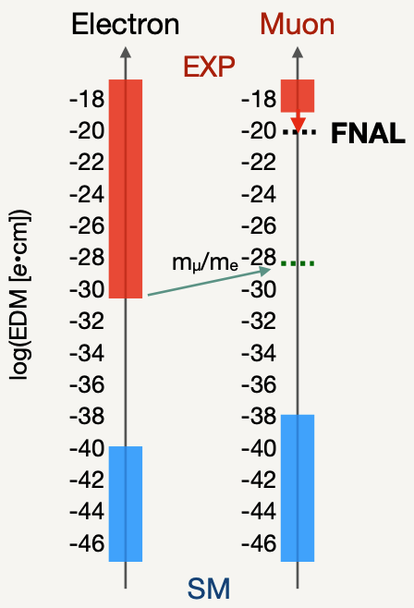
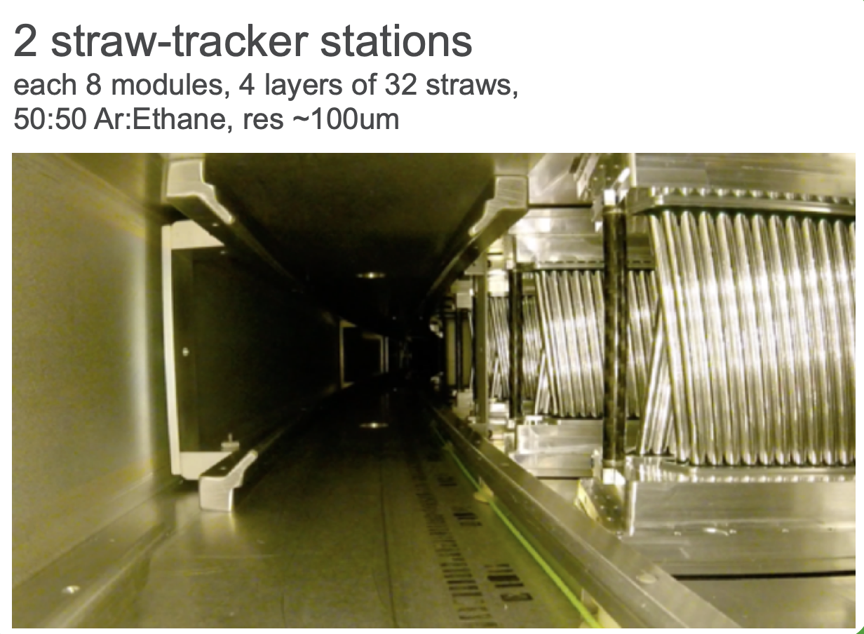



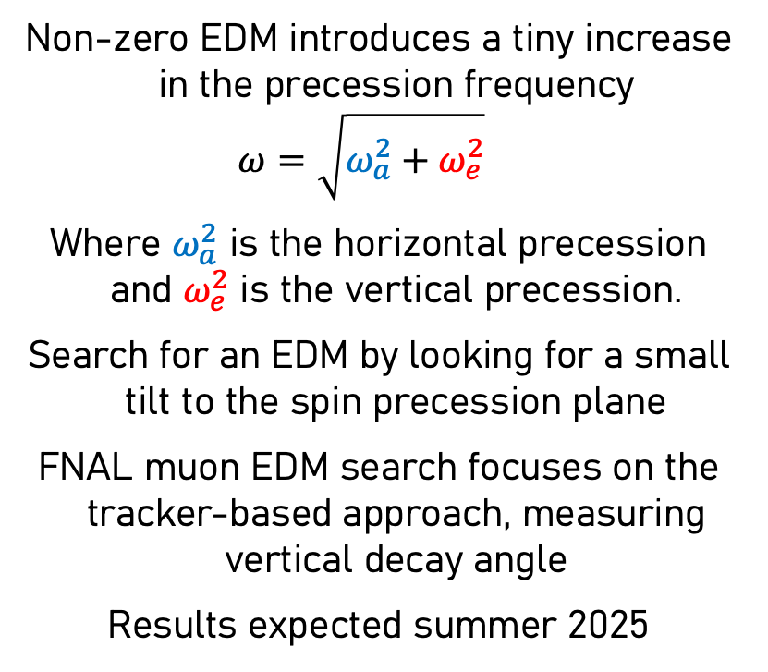
Non-zero EDM introduces a tiny increase in the precession frequency
$$ω=\sqrt{ω_{a}^{2}+ω_{e}^{2}}$$
Where $ω_{a}^{2}$ is the horizontal precession and $ω_{e}^{2}$ is the vertical precession.
Search for an EDM by looking for a small tilt to the spin precession plane
FNAL muon EDM search focuses on the tracker-based approach, measuring vertical decay angle
Results expected summer 2025
Made in Liverpool

Slide 17

Thank you Very Much

