Slide 1
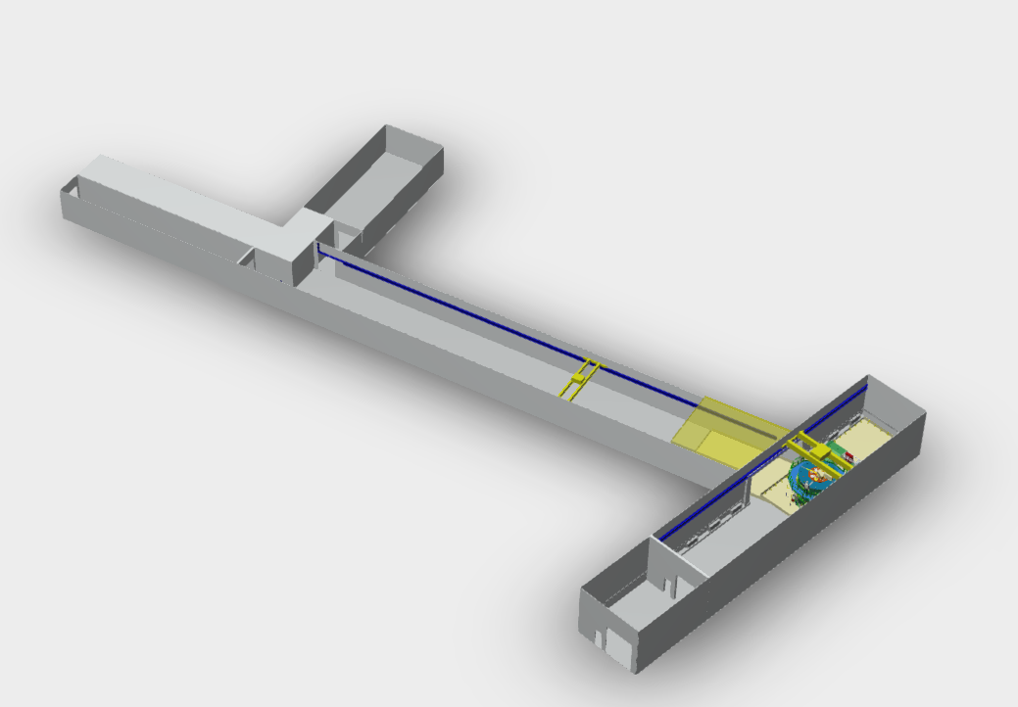
Step translation of current model uploaded to Autodesk Drive – the step translation is available if you click on the download button
https://autode.sk/3XTJKVJ

Slide 2
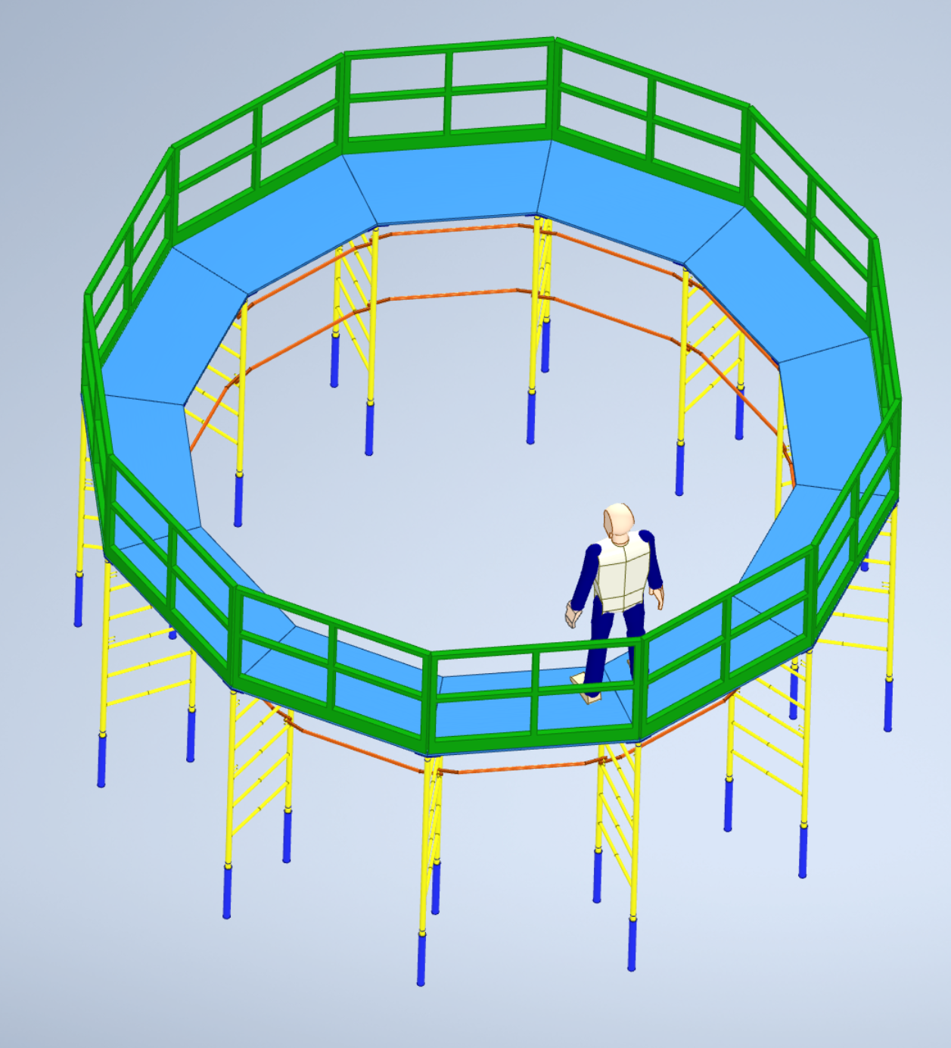
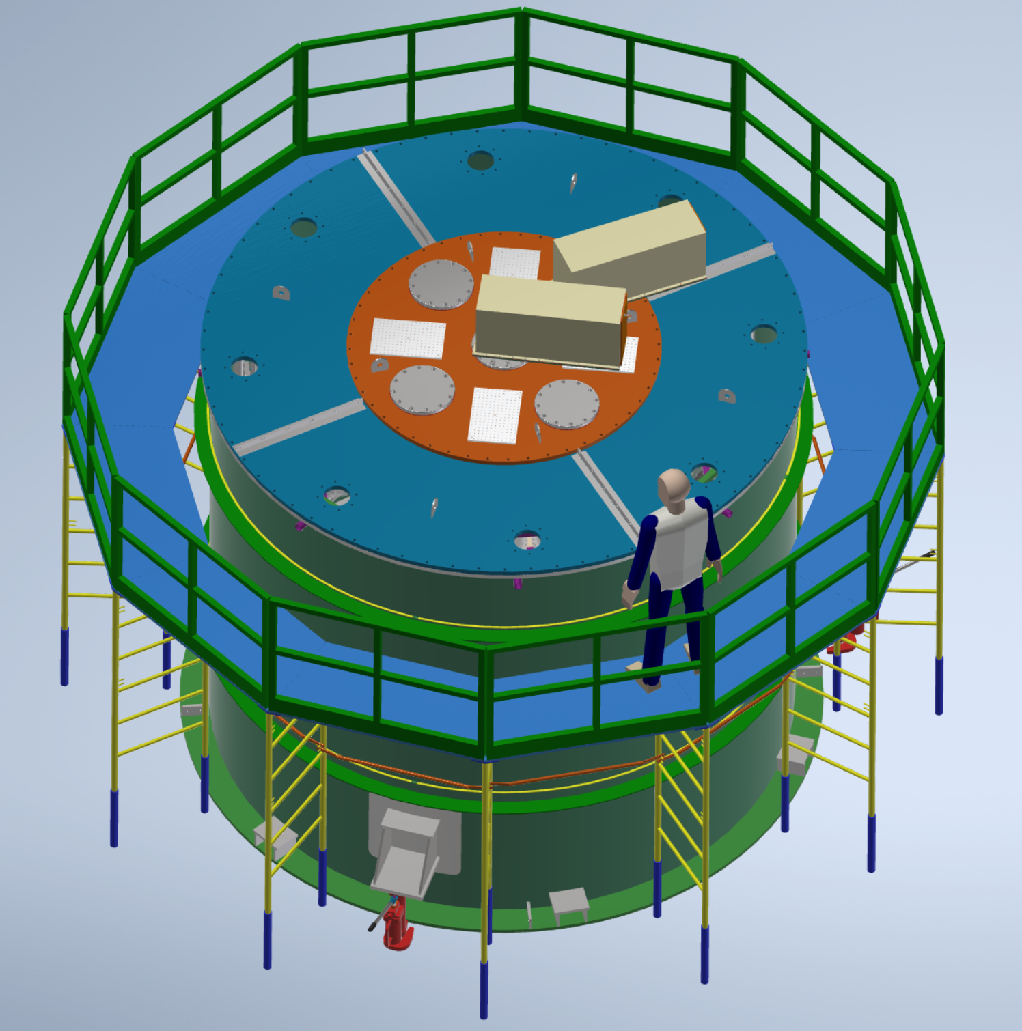
Placeholder scaffold assembly

Slide 3
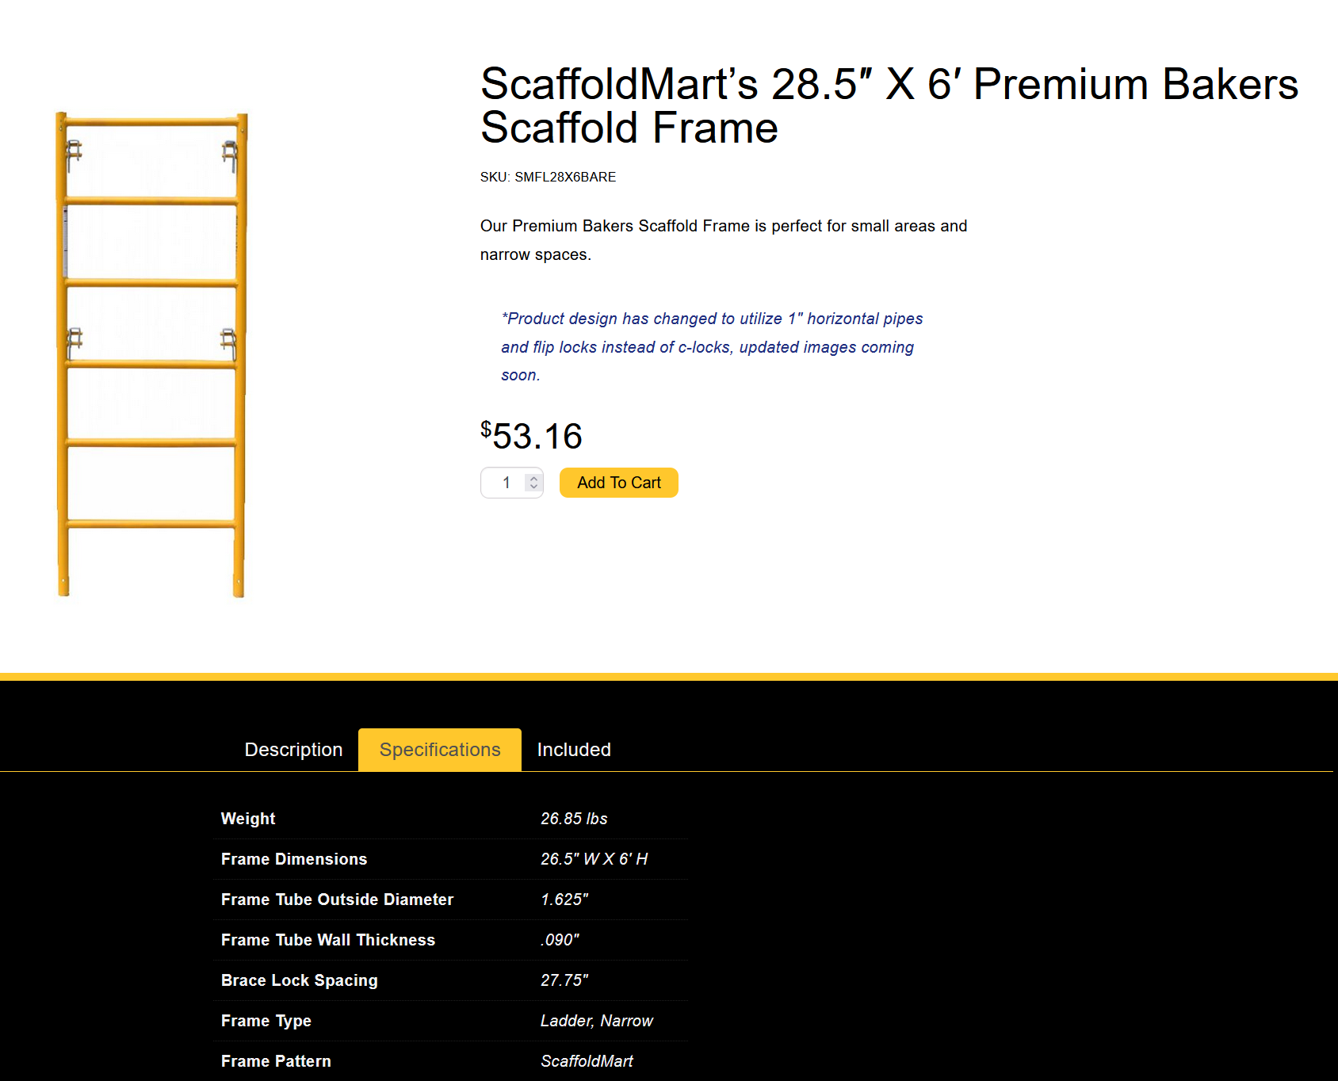
Scaffold element used in placeholder scaffold assembly
https://scaffoldmart.com/sm-28-5-x6-premium-bakers-frame/

Slide 4
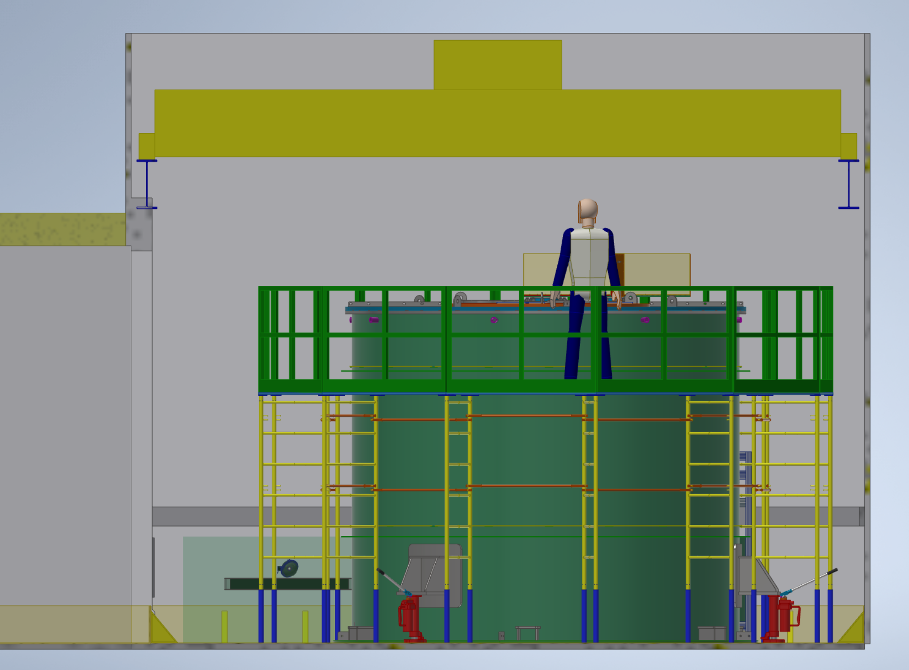

Slide 5
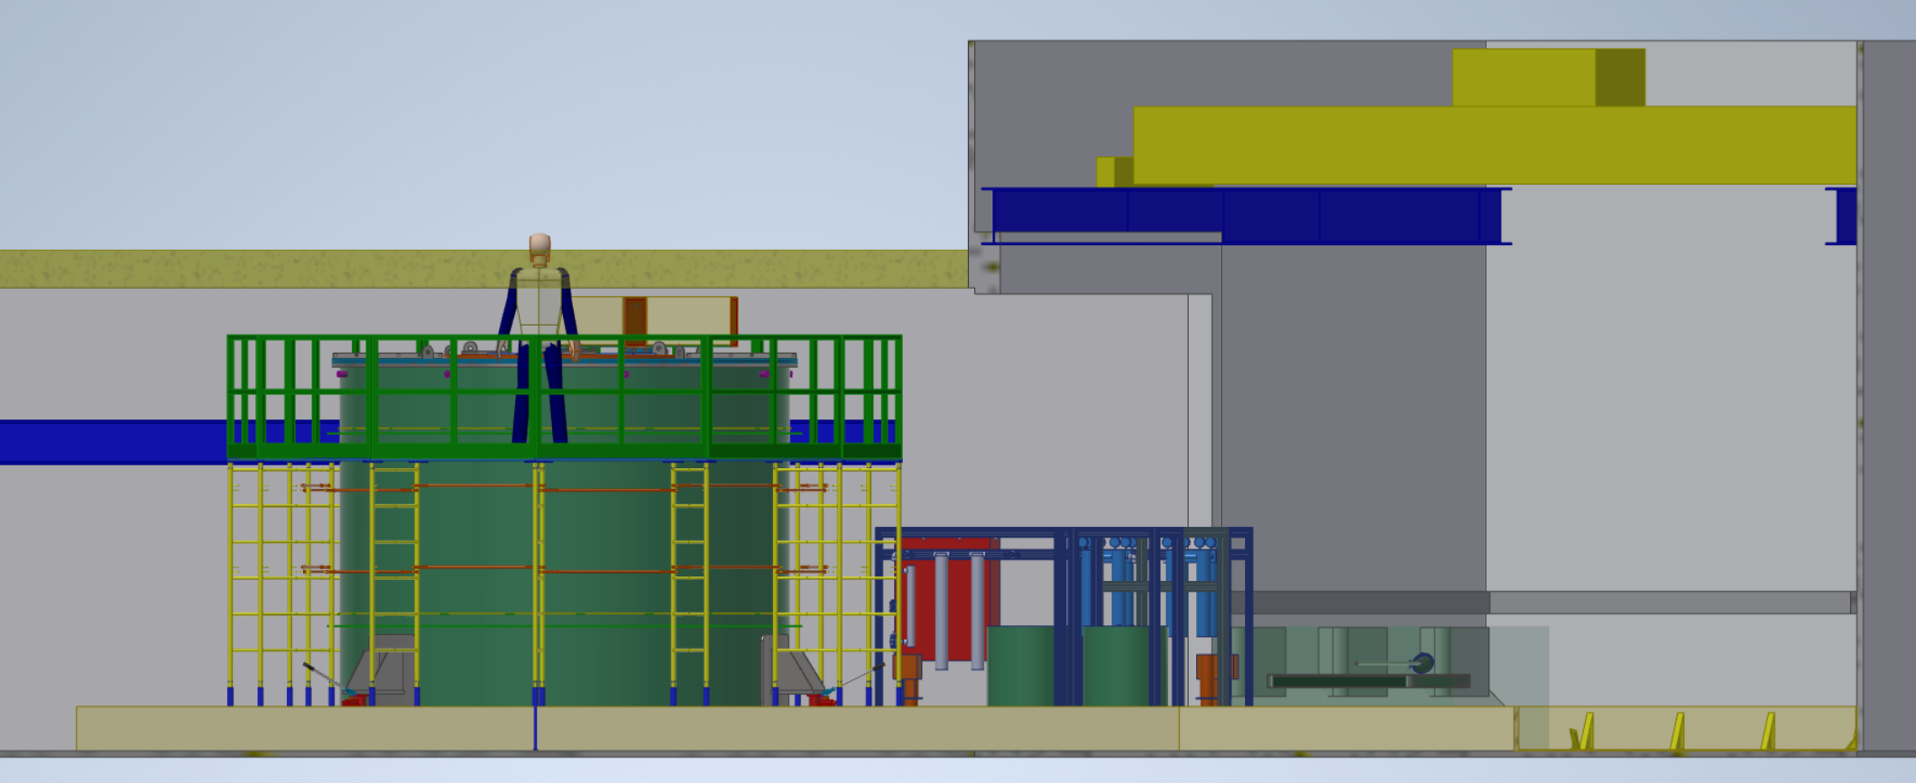
Interference in Model
73mm
4098mm
23mm

Slide 6
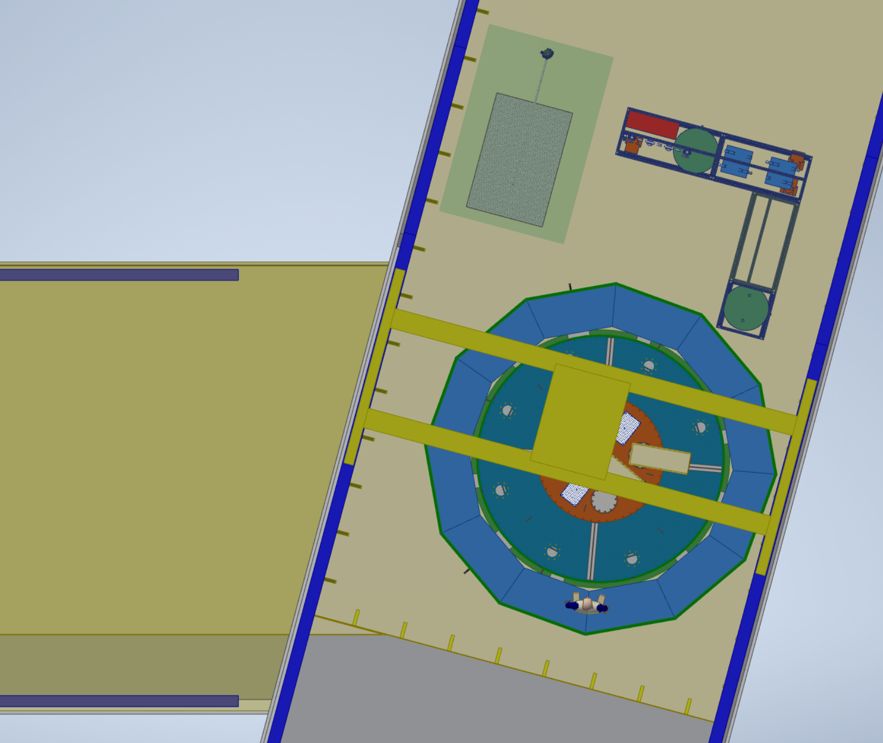
Attenuation Module
Water Module
LEC Configuration

Slide 7
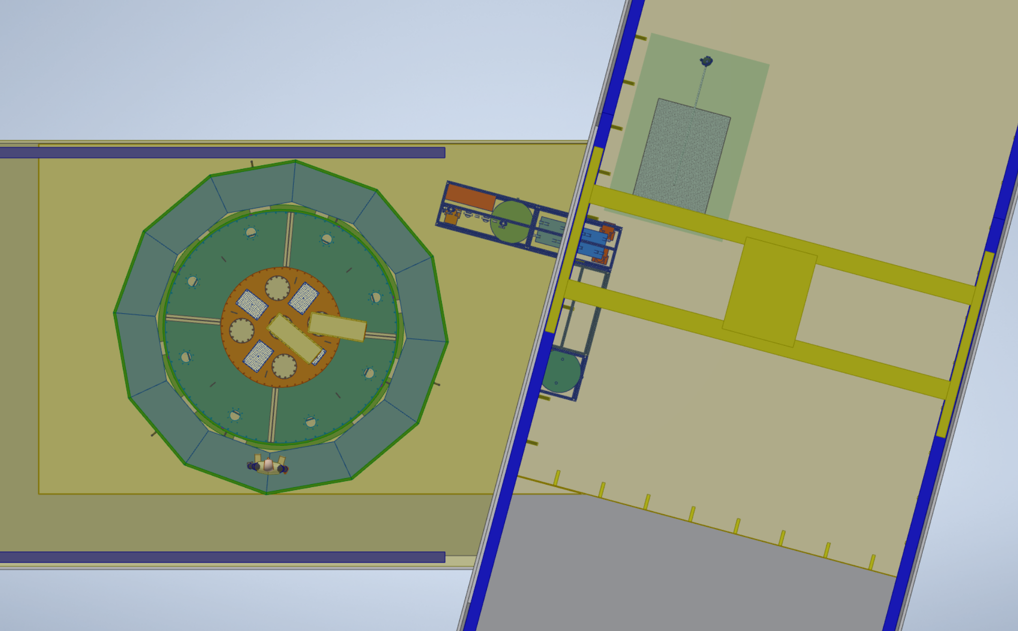
Main Hall Configuration

Slide 8
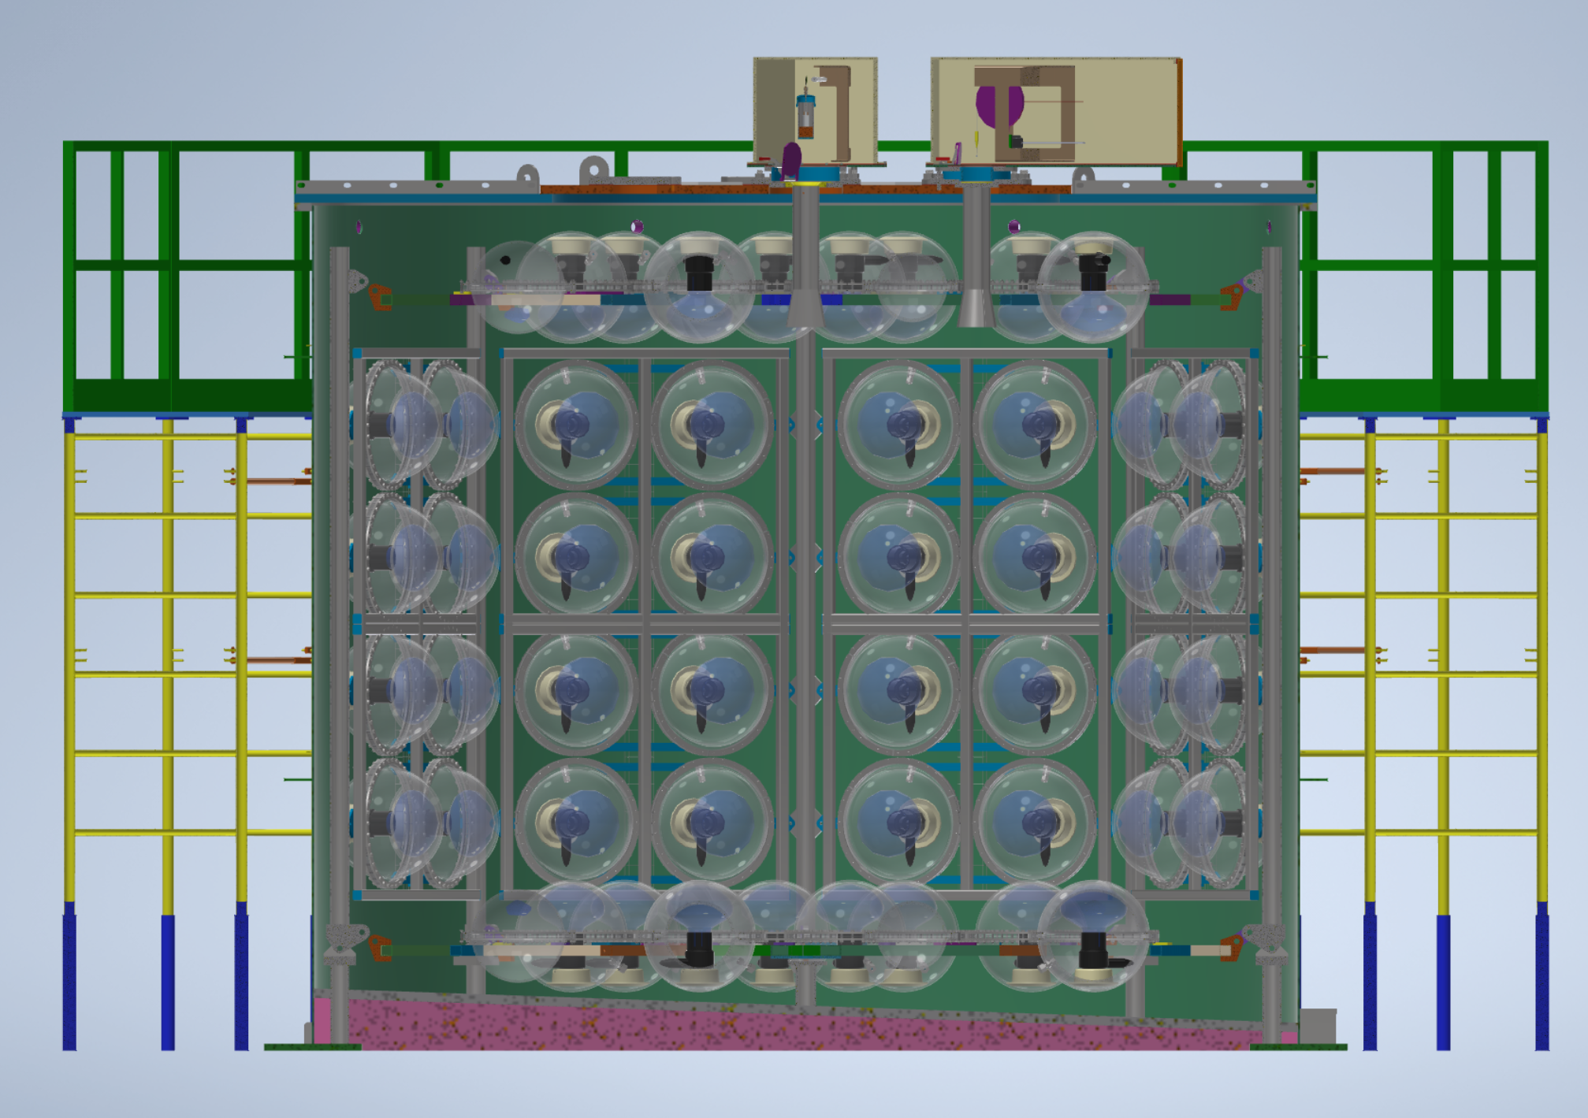
Tank bottom thermal insulation

